Slide 1
CSE3400 Intro to Cyber-Security: Crypto-Hash Functions And applications
Prof. Amir Herzberg
CSE dept., Univ. of Connecticut
Last updated: Tuesday, February 11, 2020

Slide 2
Crypto-Hash functions
Introduction to cryptographic hash
Integrity: collision-resistance
Hash h(m) allows verification of m
Applications: file distribution, signing, blockchains,...
Confidentiality: one-way functions (OWF)
OWF-hash h(m) does not expose m
Pseudo-randomness
If m is ‘sufficiently random’, then h(m) is pseudorandom
Notes:
Today’s I will introduce you to the topic of cryptography for blockchains; unfortunately I will not be able to stay for the rest of the days of this workshop but I believe you will find this to provide important background to the more advanced topics that will be covered in the later days. Cryptography, you know, is in Greek, and initially referred to incomprehensible, cryptic communication; I will do my best to make sure that what I present will not be too cryptic and you will be able to understand, however, please help me by asking many questions whenever something is not clear. Specifically, we focus on the cryptographic tools used for blockchains, which are mostly public key signatures and cryptographic hash functions. These are non-trivial and somewhat technical topics, but if we work hard together, I hope that at the end of the day you will understand them quite well, and they will not be a hash of concepts but clear tools, ready for use in the rest of this week and in the future. We will have four parts or blocks to this day. In the first block, we will discuss crypto-hash functions and introduce blockchains from the cryptographic point of view. In the second block, we introduce a bit more crypto and discuss pk-sign and crhf. In the third block, we discuss other important properties of crypto hash, beyond crhf. Finally, our last lecture will attempt to connect all these blocks and wrap up the topic of crypto and hashing for blockchains.

Slide 3



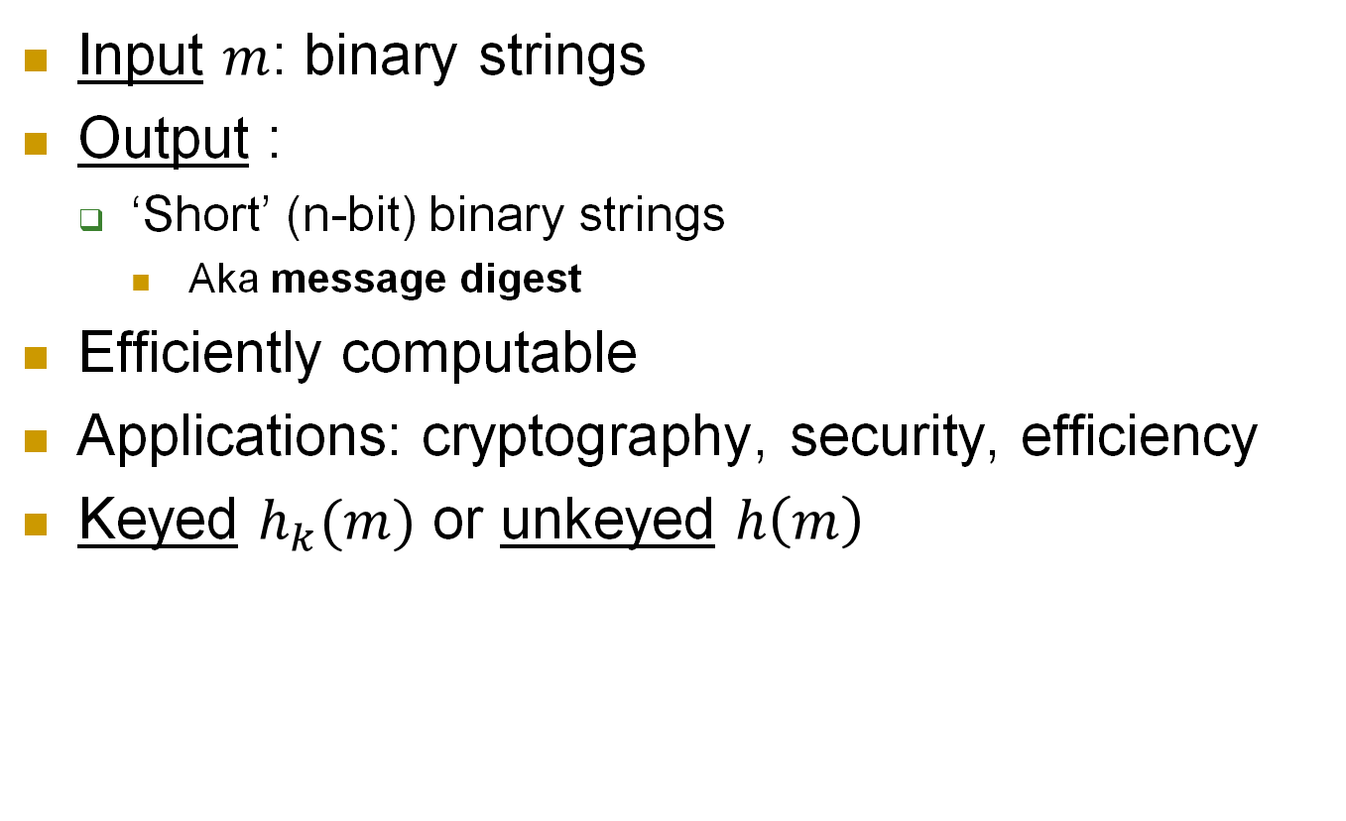



Hash functions
Input $m$: binary strings
Output :
‘Short’ (n-bit) binary strings
Aka message digest
Efficiently computable
Applications: cryptography, security, efficiency
Keyed $h_{k}(m)$ or unkeyed $h\left(m\right)$
$$m$$
$$m$$
k
$$h$$
$$h$$
$$h(m)$$
$$h(m)$$

Slide 4

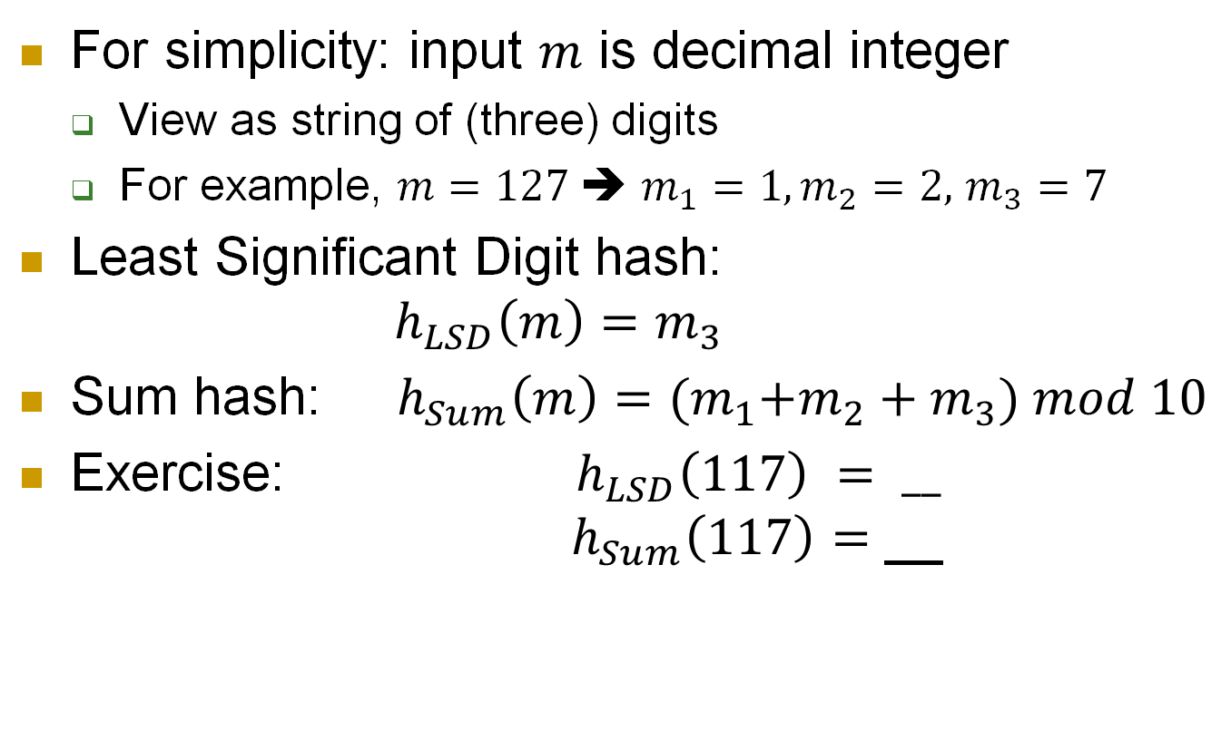


Hash functions: simple examples
$$m$$
$$h$$
For simplicity: input $m$ is decimal integer
View as string of (three) digits
For example, $m=127$➔ $m_{1}=1,m_{2}=2,$ $m_{3}=7$
Least Significant Digit hash: $h_{LSD}\left(m\right)=m_{3}$
Sum hash: $h_{Sum}\left(m\right)={{(m}_{1}+m_{2}+m}_{3}) mod 10$
Exercise: ${ h}_{LSD}\left(117\right) {= __}_{}$ $h_{Sum}\left(117\right)=$ __
$$h(m)$$
7
9

Slide 5


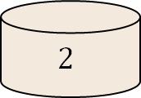

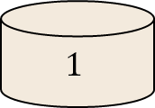
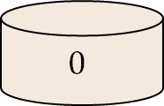
Hashing for efficiency
Input: large set (e.g., integers or strings)
Goal: map `randomly’ to few bins
E.g., to ensure efficiency – load balancing, etc.
Could adversary choose inputs to defeat hash?
341,
3342,
870,
571,
31,
452,
80,
….
$$h_{LSD}$$
341,
571,
31,
….
3342,
452,
….
870,
80,
….
. . .
$$1$$
$$2$$
. . .
$$0$$

Slide 6


Hashing for efficiency
Input: large set (e.g., integers or strings)
Goal: map `randomly’ to few bins
E.g., to ensure efficiency – load balancing, etc.
Adversary chooses inputs that hash to same bin
32,
42,
52,
62,
31,
452,
80,
….
$$h_{LSD}$$
Inputs to overload the `2’ bin
31,
….
32, 42,
52, 62,
452,
….
80,
….
. . .
Algorithmic
Complexity
Denial-of-Service
Attack
$$1$$
$$2$$
. . .
$$0$$

Slide 7
Crypto-Hashing & Blockchains
Introduction to cryptographic hash
Integrity: collision-resistance and blockchains
Hash h(m) allows verification of m
Confidentiality: one-way functions (OWF)
OWF-hash h(m) does not expose m
Pseudo-randomness
If m contains some random bits, then h(m) is pseudorandom
Notes:
Today’s I will introduce you to the topic of cryptography for blockchains; unfortunately I will not be able to stay for the rest of the days of this workshop but I believe you will find this to provide important background to the more advanced topics that will be covered in the later days. Cryptography, you know, is in Greek, and initially referred to incomprehensible, cryptic communication; I will do my best to make sure that what I present will not be too cryptic and you will be able to understand, however, please help me by asking many questions whenever something is not clear. Specifically, we focus on the cryptographic tools used for blockchains, which are mostly public key signatures and cryptographic hash functions. These are non-trivial and somewhat technical topics, but if we work hard together, I hope that at the end of the day you will understand them quite well, and they will not be a hash of concepts but clear tools, ready for use in the rest of this week and in the future. We will have four parts or blocks to this day. In the first block, we will discuss crypto-hash functions and introduce blockchains from the cryptographic point of view. In the second block, we introduce a bit more crypto and discuss pk-sign and crhf. In the third block, we discuss other important properties of crypto hash, beyond crhf. Finally, our last lecture will attempt to connect all these blocks and wrap up the topic of crypto and hashing for blockchains.

Slide 8
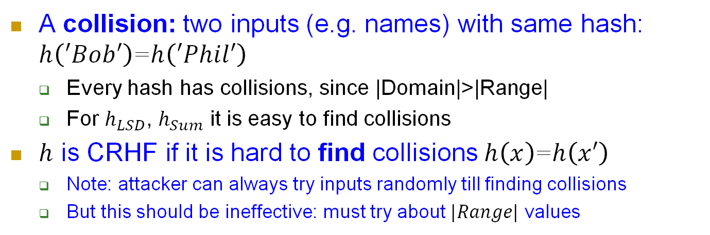


Collision Resistance Hash Function (CRHF)
A collision: two inputs (e.g. names) with same hash: $h\left(′Bob′\right)$=$h\left(′Phil′\right)$
Every hash has collisions, since |Domain|>|Range|
For $h_{LSD}$, $h_{Sum}$ it is easy to find collisions
$h$ is CRHF if it is hard to find collisions $h\left(x\right)$=$h\left(x′\right)$
Note: attacker can always try inputs randomly till finding collisions
But this should be ineffective: must try about $|Range|$ values
342
$$h_{Sum}$$
${__=h}_{Sum}$(342)=$h_{Sum}$(___)
9
63
Domain
Range
63
Notes:
To make it hard to compute h, use a secret key (which means that we actually use a PRF, not a hash function),

Slide 9


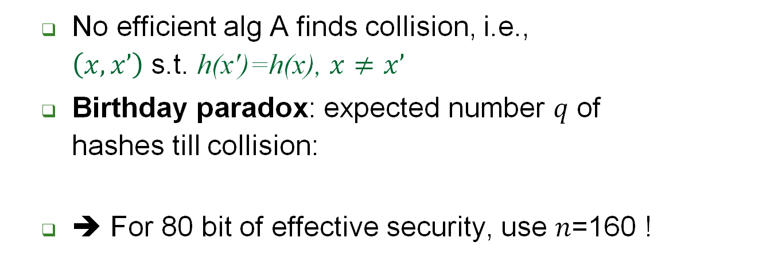


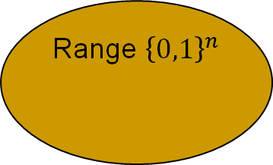
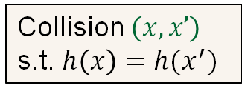
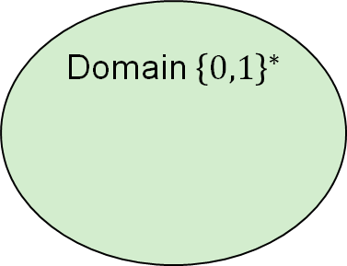

Collision-Resistance (CRHF)
Domain ${\left\{0,1\right\}}^{∗}$
Adversary
Hash function $h\left(∙\right)$
Range ${\left\{0,1\right\}}^{n}$
$$x∘$$
Collision $\left(x,x’\right)$
s.t. $h\left(x\right)=h(x^{′})$
$$x′∘$$
$$∘h\left(x\right)=h(x^{′})$$
No efficient alg A finds collision, i.e., $\left(x,x’\right)$ s.t. h(x')=h(x), $x≠x’$
Birthday paradox: expected number 𝑞 of hashes till collision:
➔ For 80 bit of effective security, use 𝑛=160 !
Notes:
9
(c) Amir Herzberg, http://AmirHerzberg.com, Bar Ilan University
04/07/06
CR>SPR [and SPR<OWF if |domain|>>|range|
Which property is required for signatures? For deriving DH/El-gamal keys?

Slide 10
Birthday paradox – keyed CRHF
expected number 𝑞 of hashes till collision:
➔ 160b digest give only 80b effective security
Applies to both keyed and keyless CRHF
x
h
k
(x
)=
Pre
-
image
h
h
(x
’
)
k
k
{
0
,
1
}
*
Range
{
0
,
1
}
L
x
’
Notes:
10
(c) Amir Herzberg, http://AmirHerzberg.com, Bar Ilan University
04/07/06

Slide 11
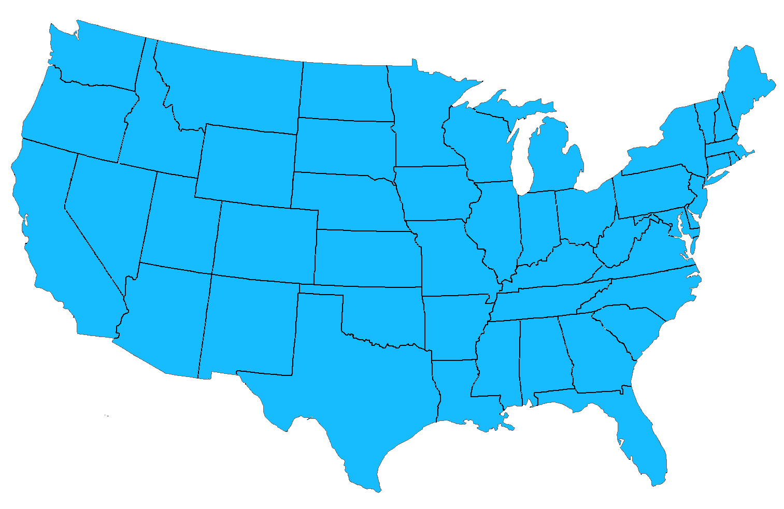
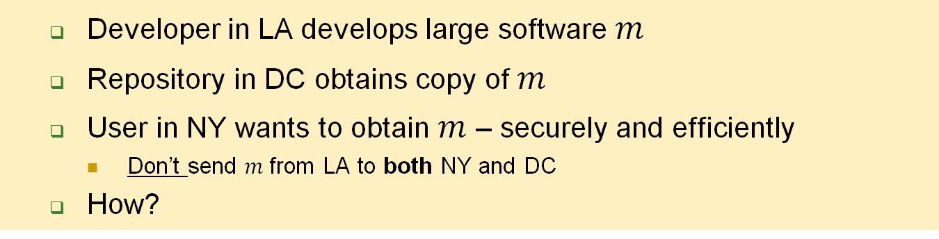

CRHF applied to sw distribution
Developer in LA develops large software $m$
Repository in DC obtains copy of $m$
User in NY wants to obtain $m$ – securely and efficiently
Don’t send $m$from LA to both NY and DC
How?
NY
User
DC
LA
$$m$$
Repository
Developer

Slide 12

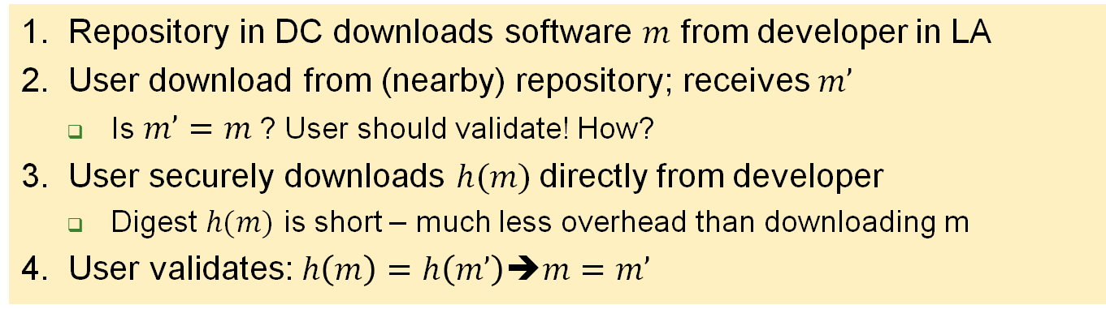




CRHF: secure, efficient SW distribution
1. Repository in DC downloads software $m$ from developer in LA
2. User download from (nearby) repository; receives $m’$
Is $m’=m$? User should validate! How?
3. User securely downloads $h(m)$directly from developer
Digest $h(m)$ is short – much less overhead than downloading m
4. User validates: $h\left(m\right)=h\left(m’\right)$➔$m=m’$
NY
User
NY
3
$$h(m)$$
2
$$m′$$
DC
$$m$$
DC
$$h$$
LA
Repository
LA
1
$$m$$
$$m$$
$$h(m)$$
Developer

Slide 13
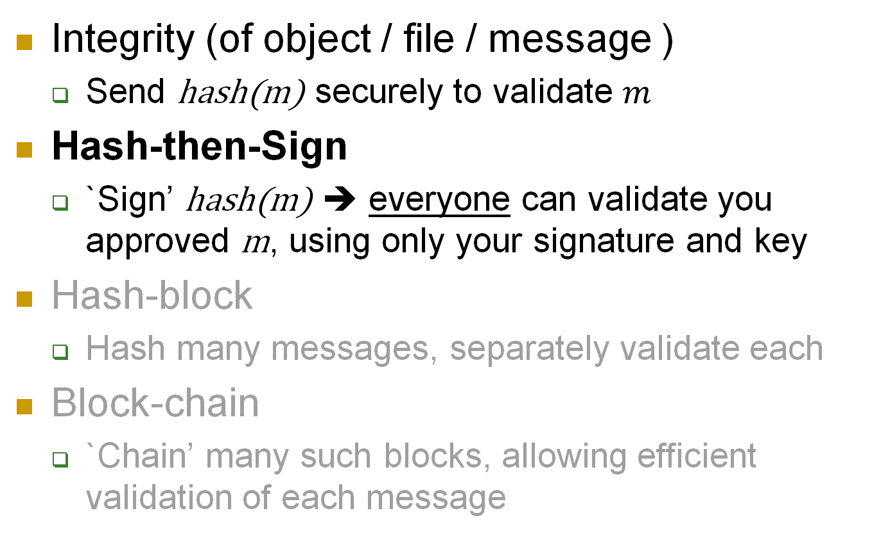
Collision-Resistance: Applications
Integrity (of object / file / message )
Send hash(m) securely to validate $m$
Hash-then-Sign
`Sign’ hash(m) ➔ everyone can validate you approved m, using only your signature and key
Hash-block
Hash many messages, separately validate each
Block-chain
`Chain’ many such blocks, allowing efficient validation of each message

Slide 14


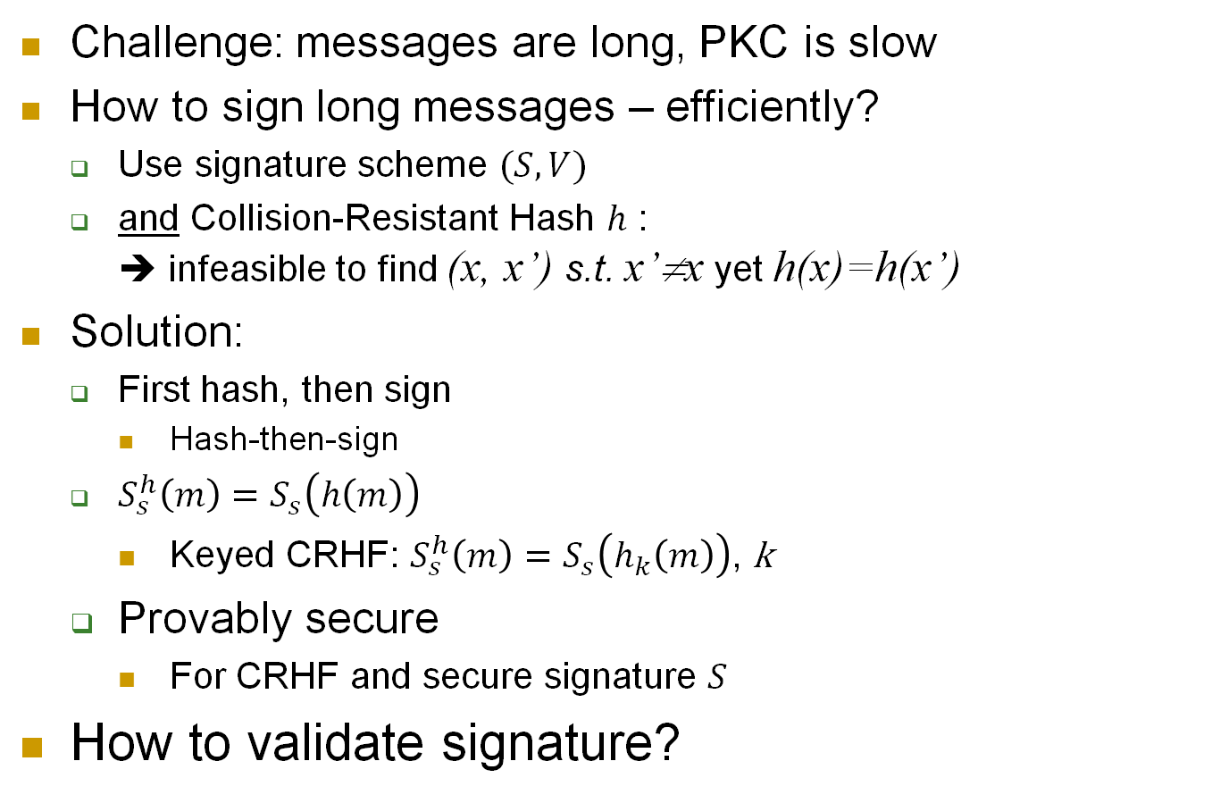
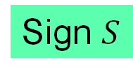


The Hash-then-Sign Paradigm
Challenge: messages are long, PKC is slow
How to sign long messages – efficiently?
Use signature scheme $(S,V)$
and Collision-Resistant Hash $h$ : ➔ infeasible to find (x, x’) s.t. x’≠x yet h(x)=h(x’)
Solution:
First hash, then sign
Hash-then-sign
$S_{s}^{h}\left(m\right)=S_{s}\left(h\left(m\right)\right)$
Keyed CRHF: $S_{s}^{h}\left(m\right)=S_{s}\left(h_{k}\left(m\right)\right)$, k
Provably secure
For CRHF and secure signature $S$
How to validate signature?
Message $m$
Hash $h$
$$h(m)$$
Sign $S$
$$S_{s}^{h}\left(m\right)$$

Slide 15

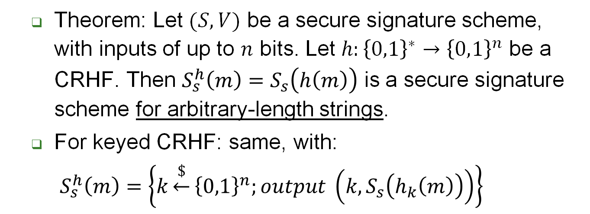

Hash-then-Sign Secure w/ CRHF
Domain ${\left\{0,1\right\}}^{∗}$
Adversary
Hash function $h\left(∙\right)$
Range ${\left\{0,1\right\}}^{n}$
$$x∘$$
$$x′∘$$
$$∘h\left(x\right)=h(x^{′})$$
Collision $\left(x,x’\right)$
Theorem: Let $(S,V)$ be a secure signature scheme, with inputs of up to $n$ bits. Let $h:{\left\{0,1\right\}}^{∗}→{\left\{0,1\right\}}^{n}$ be a CRHF. Then $S_{s}^{h}\left(m\right)=S_{s}\left(h\left(m\right)\right)$ is a secure signature scheme for arbitrary-length strings.
For keyed CRHF: same, with: $S_{s}^{h}\left(m\right)=\left\{k\underset{←}{\$}{\left\{0,1\right\}}^{n};output \left(k,S_{s}\left(h_{k}\left(m\right)\right)\right)\right\}$
Notes:
15
(c) Amir Herzberg, http://AmirHerzberg.com, Bar Ilan University
04/07/06
CR>SPR [and SPR<OWF if |domain|>>|range|
Which property is required for signatures? For deriving DH/El-gamal keys?

Slide 16
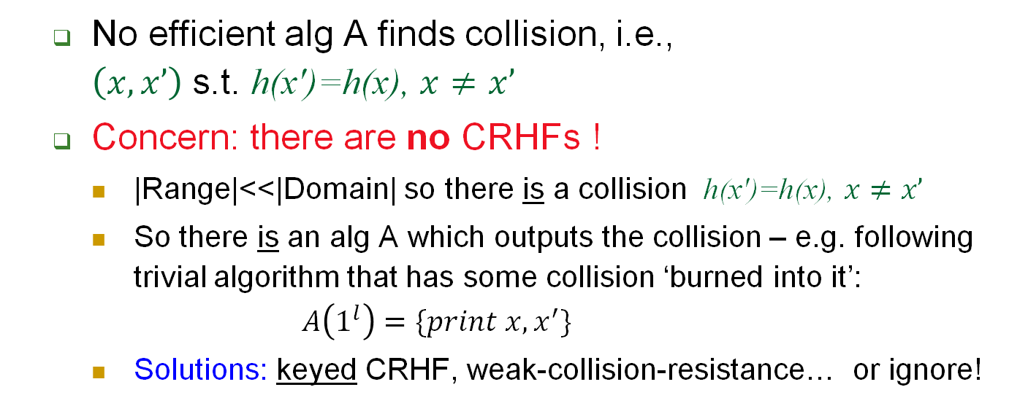
Collision-Resistance (CRHF)
Domain ${\left\{0,1\right\}}^{∗}$
Adversary
Hash function $h\left(∙\right)$
Range ${\left\{0,1\right\}}^{n}$
$$x∘$$
Collision $\left(x,x’\right)$
s.t. $h\left(x\right)=h(x^{′})$
$$x′∘$$
$$∘h\left(x\right)=h(x^{′})$$
No efficient alg A finds collision, i.e., $\left(x,x’\right)$ s.t. h(x')=h(x), $x≠x’$
Concern: there are no CRHFs !
|Range|<<|Domain| so there is a collision h(x')=h(x), $x≠x’$
So there is an alg A which outputs the collision – e.g. following trivial algorithm that has some collision ‘burned into it’: $A\left(1^{l}\right)=\{print x, x^{′}\}$
Solutions: keyed CRHF, weak-collision-resistance… or ignore!
Notes:
16
(c) Amir Herzberg, http://AmirHerzberg.com, Bar Ilan University
04/07/06
CR>SPR [and SPR<OWF if |domain|>>|range|
Which property is required for signatures? For deriving DH/El-gamal keys?

Slide 17
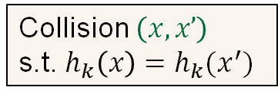


Keyed CRHF
Keyed Collision Resistant Hash Function (CRHF): any adversary, given k∈_{R}{0,1}^{n}, x∈{0,1}* cannot efficiently find collision, i.e. x’ such that x≠x’ yet h_{k}(x)=h_{k}(x’).
$$k\underset{←}{\$}{\left\{0,1\right\}}^{n}$$
Adversary
x
$$h_{k}\left(x\right)=h_{k}(x^{′})$$
Pre
-
image
h
k
Range
{
0
,
1
}
*
{
0
,
1
}
n
Collision $\left(x,x’\right)$
s.t. $h_{k}\left(x\right)=h_{k}(x^{′})$
x
’
Adversary knows k but not in advance – cannot `know` a collision
Birthday paradox still applies!
Notes:
17
(c) Amir Herzberg, http://AmirHerzberg.com, Bar Ilan University
04/07/06

Slide 18
Birthday paradox
expected number 𝑞 of hashes till collision:
➔ 160b digest give only 80b effective security
Applies to both keyed and keyless CRHF
x
h
k
(x
)=
Pre
-
image
h
h
(x
’
)
k
k
{
0
,
1
}
*
Range
{
0
,
1
}
L
x
’
Notes:
18
(c) Amir Herzberg, http://AmirHerzberg.com, Bar Ilan University
04/07/06

Slide 19



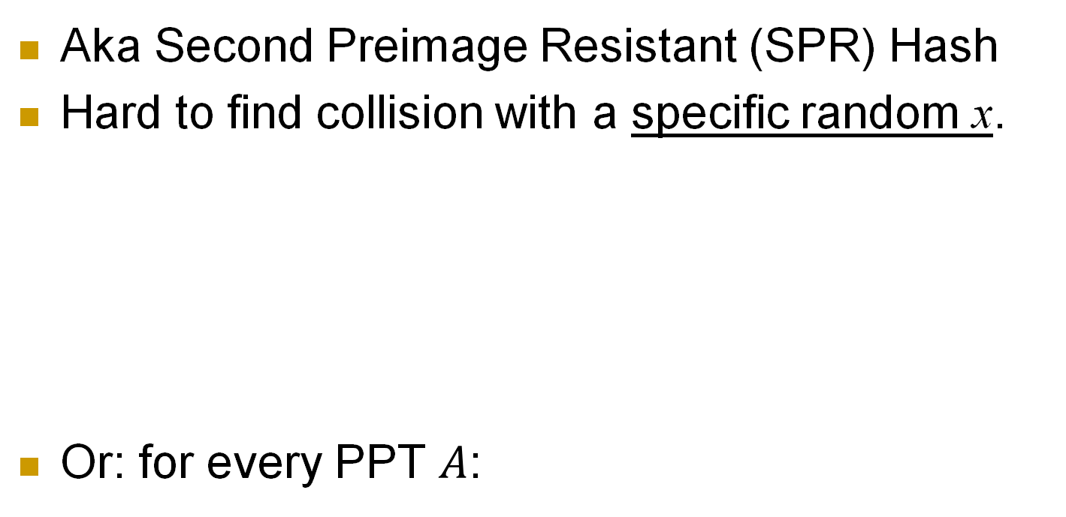






Weakly-Collision-Resistant Hash
Aka Second Preimage Resistant (SPR) Hash
Hard to find collision with a specific random x.
Or: for every PPT $A$:
$$x\underset{←}{\$}{\left\{0,1\right\}}^{m}$$
Domain ${\left\{0,1\right\}}^{∗}$
Hash function $h\left(∙\right)$
Range ${\left\{0,1\right\}}^{n}$
Adversary
First preimage
$$x∘$$
Second preimage
$$x′∘$$
$$∘h\left(x\right)=h(x^{′})$$
$x’$ s.t. $x′≠x$
Use with care!
Use only where allowed
Notes:
19
(c) Amir Herzberg, http://AmirHerzberg.com, Bar Ilan University
04/07/06

Slide 20

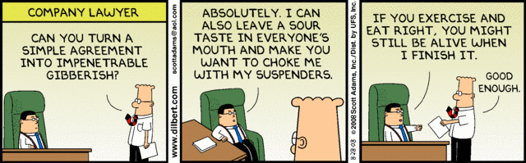
CRHF/SPR vs. Applications
CRHF secure for signing, sw-distribution
How about SPR hash (weak-CRHF)?
SW-distribution?
Hash-then-sign?
Why?
Attacker can’t impact sw to be distributed
But… attacker may be able to impact signed msg!
Will/Contract/…
Sign_{A}(h(Will/Contract/…))

Slide 21


SPR: collisions to chosen message
Or: Alice and Mal, the corrupt lawyer
Mal finds two `colliding wills’, GoodW and BadW:
GoodW: contents agreeable to Alice
h(GoodW)=h(BadW)
Alice Signs good will: Sign_{A}(h(GoodW))
Later… Mal presents to the court:
Is such attack realistic, or is SPR enough ‘in practice’?
h(GoodP)=h(BadP)
GoodW: ‘I leave all to Bob’
Sign_{A}(h(GoodW))
BadW: ‘I leave all to Mal’, Sign_{A}(h(BadW))
$$$$

Slide 22
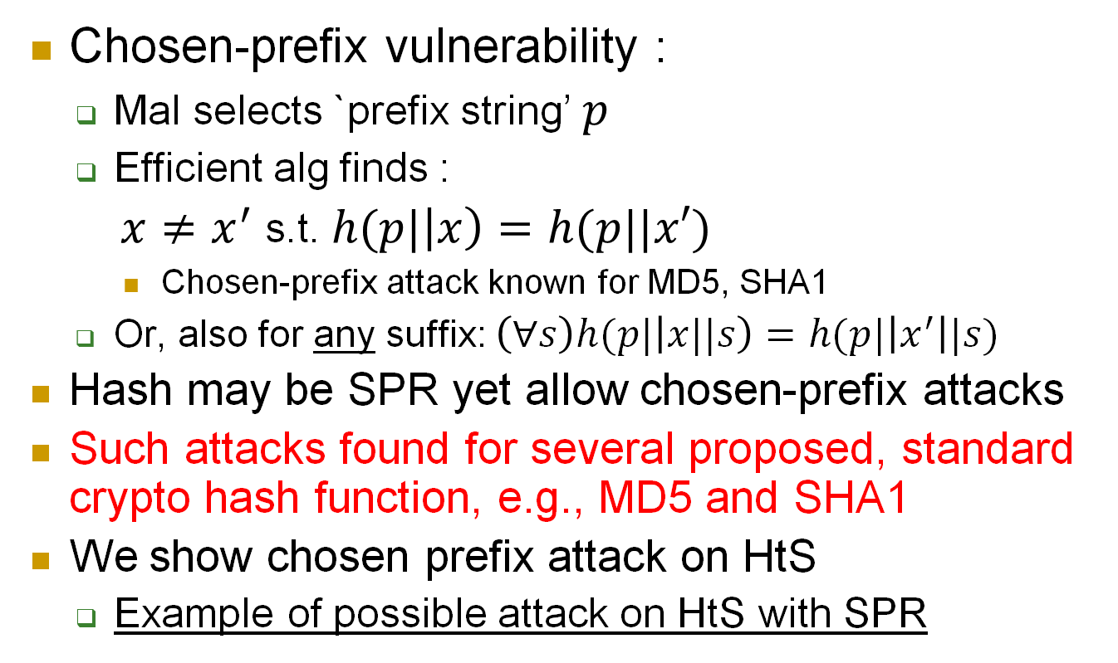
SPR & Chosen-prefix vulnerability
Chosen-prefix vulnerability :
Mal selects `prefix string’ $p$
Efficient alg finds :
$x≠x^{′}$ s.t. $h(p|\left|x\right)=h(p||x′)$
Chosen-prefix attack known for MD5, SHA1
Or, also for any suffix: $\left(∀s\right)h(p|\left|x||s\right)=h(p|\left|x^{′}\right||s)$
Hash may be SPR yet allow chosen-prefix attacks
Such attacks found for several proposed, standard crypto hash function, e.g., MD5 and SHA1
We show chosen prefix attack on HtS
Example of possible attack on HtS with SPR
Notes:
22
(c) Amir Herzberg, http://AmirHerzberg.com, Bar Ilan University
04/07/06

Slide 23
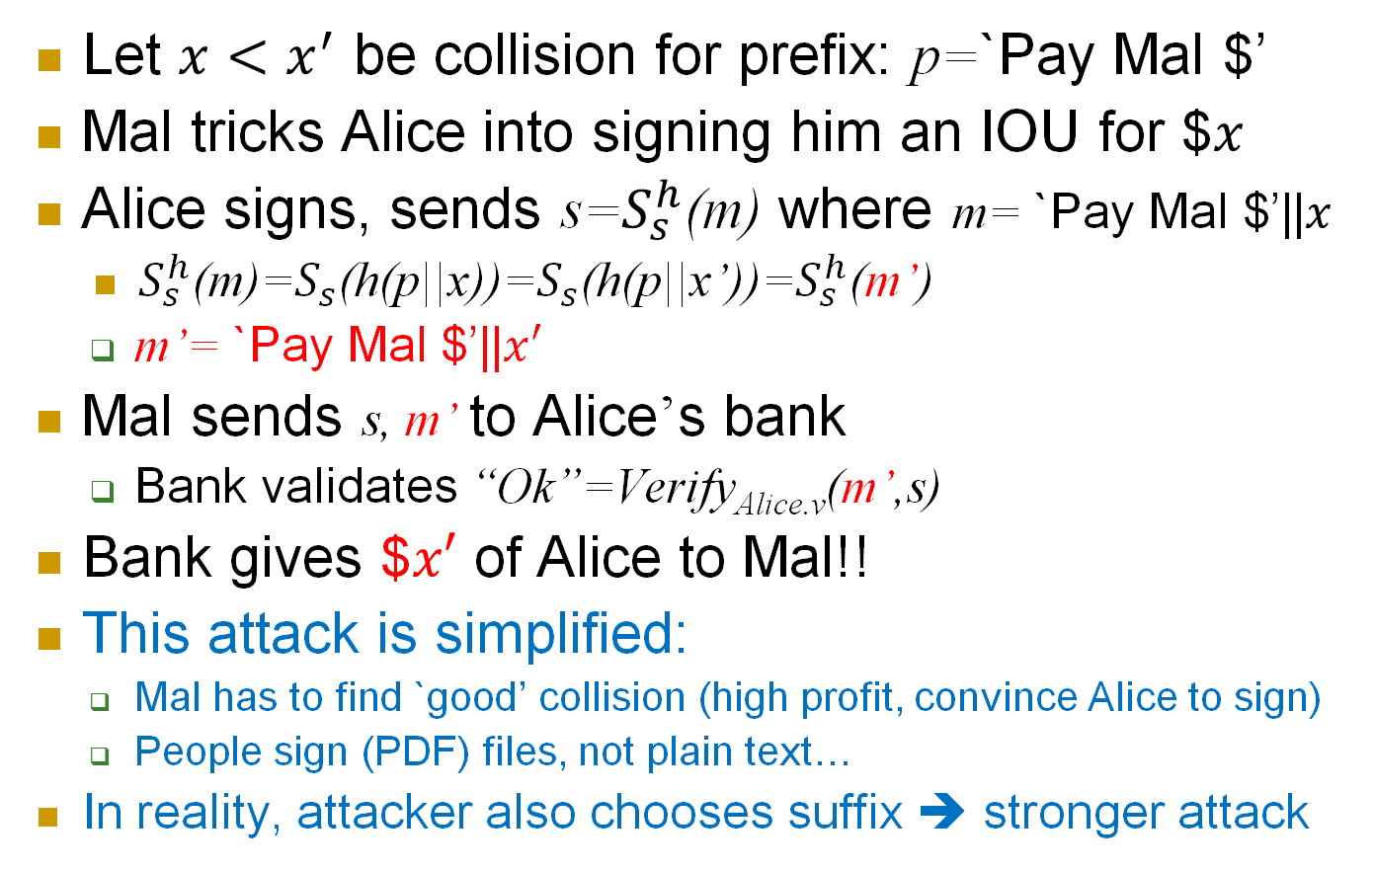
Chosen-prefix attack
Let $x<x^{′}$ be collision for prefix: p=`Pay Mal $’
Mal tricks Alice into signing him an IOU for $$x$
Alice signs, sends s=$S_{s}^{h}$(m) where m= `Pay Mal $’||$x$
$S_{s}^{h}$(m)=$S_{s}$(h(p||x))=$S_{s}$(h(p||x’))=$S_{s}^{h}$(m’)
m’= `Pay Mal $’||$x′$
Mal sends s, m’ to Alice’s bank
Bank validates “Ok”=Verify_{Alice.v}(m’,s)
Bank gives $$x′$ of Alice to Mal!!
This attack is simplified:
Mal has to find `good’ collision (high profit, convince Alice to sign)
People sign (PDF) files, not plain text…
In reality, attacker also chooses suffix ➔ stronger attack

Slide 24
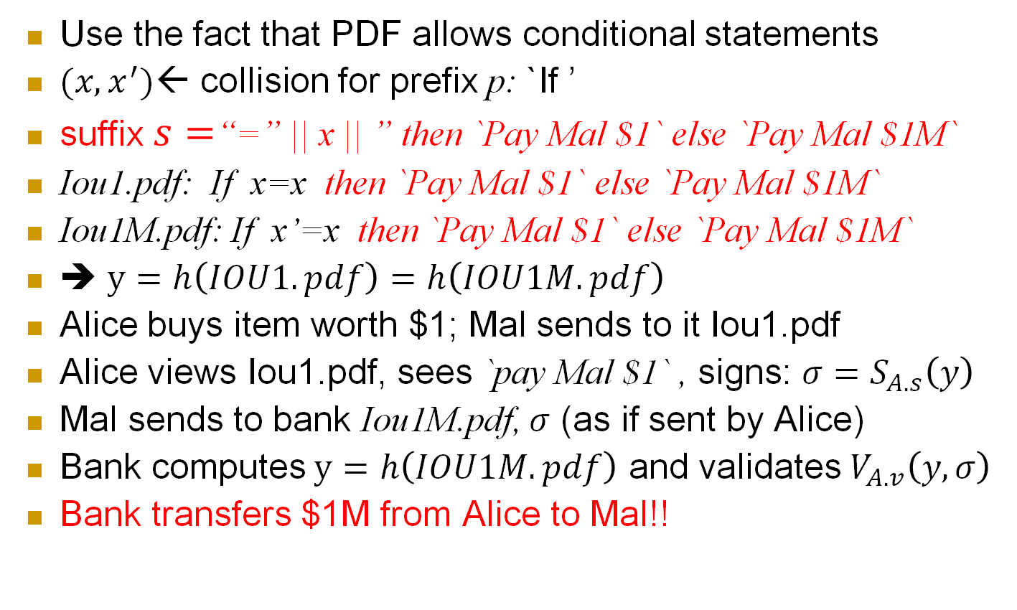
Chosen-prefix attack on PDF files
Use the fact that PDF allows conditional statements
$(x,x^{′})$← collision for prefix p: `If ’
suffix $s=$“=” || x || ” then `Pay Mal $1` else `Pay Mal $1M`
Iou1.pdf: If x=x then `Pay Mal $1` else `Pay Mal $1M`
Iou1M.pdf: If x’=x then `Pay Mal $1` else `Pay Mal $1M`
➔ $y=h\left(IOU1.pdf\right)=h\left(IOU1M.pdf\right)$
Alice buys item worth $1; Mal sends to it Iou1.pdf
Alice views Iou1.pdf, sees `pay Mal $1` , signs: $σ=S_{A.s}\left(y\right)$
Mal sends to bank Iou1M.pdf, $σ$ (as if sent by Alice)
Bank computes$y=h\left(IOU1M.pdf\right)$ and validates $V_{A.v}\left(y,σ\right)$
Bank transfers $1M from Alice to Mal!!

Slide 25
CRHF Applications
Integrity (of object / file / message )
Hash-then-Sign
Hash-block
Block-chain

Slide 26





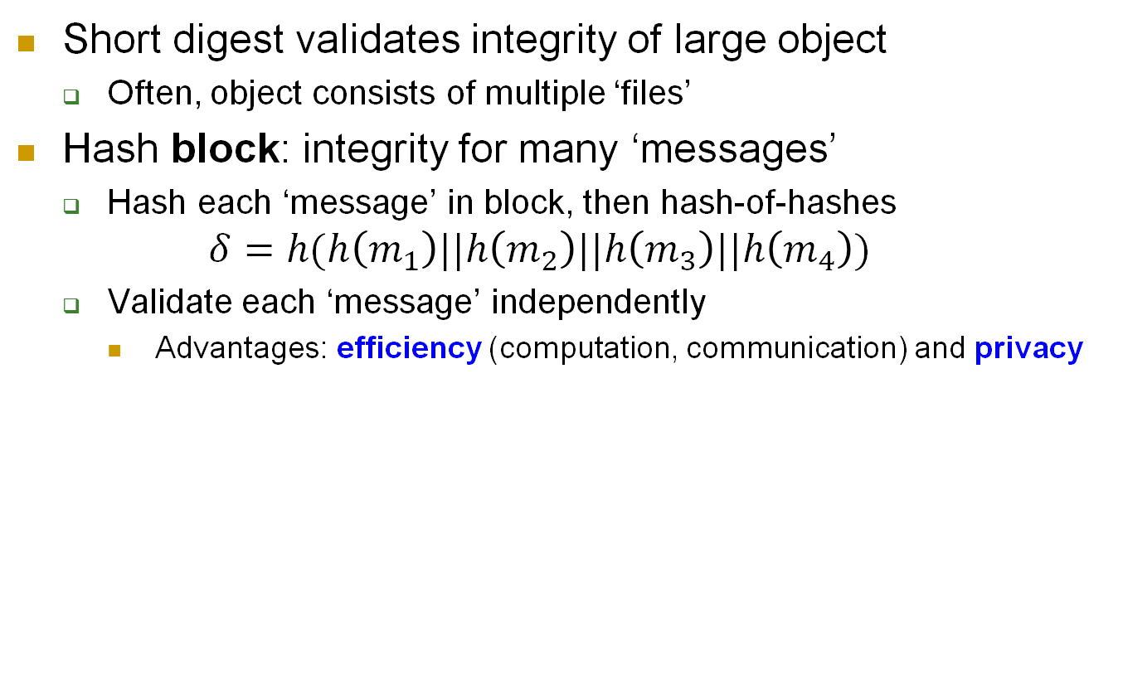






Hash Block: efficient, private integrity
Short digest validates integrity of large object
Often, object consists of multiple ‘files’
Hash block: integrity for many ‘messages’
Hash each ‘message’ in block, then hash-of-hashes $δ=h(h\left(m_{1}\right)||h\left(m_{2}\right)||h\left(m_{3}\right)||h\left(m_{4}\right))$
Validate each ‘message’ independently
Advantages: efficiency (computation, communication) and privacy
$$m_{1}$$
$$m_{2}$$
$$m_{3}$$
$$m_{4}$$
$$h$$
$$h$$
$$h$$
$$h$$
$$h(m_{1})$$
$$h(m_{2})$$
$$h(m_{3})$$
$$h(m_{4})$$
$$h$$
$$δ$$

Slide 27









Hash Block: integrity for many items
Hash efficiently validates integrity of one large item $m$
All users obtain securely $h(m)$ to validate $m$
Hash block: one digest $y$ validates many items $m_{1}$,$m_{2}$,…
Hash each item in block separately: $x_{1}=h\left(m_{1}\right),x_{2}=h\left(m_{2}\right), …$
Digest of block is hash of all digest: $y=h\left(x_{1},x_{2}, … \right)$
$$m_{1}$$
$$m_{2}$$
$$m_{3}$$
$$m_{4}$$
$$h$$
$$h$$
$$h$$
$$h$$
$$h(m_{1})$$
$$h(m_{2})$$
$$h(m_{3})$$
$$h(m_{4})$$
$$x_{1}$$
$$x_{2}$$
$$x_{4}$$
$$h$$
$$y$$
Allows each user to receive, validate only one or few required items. How?

Slide 28






Hash Block: efficient validation
Hash block: one digest $y$ validates many items $m_{1}$,$m_{2}$,…
Hash each item in block separately: $x_{1}=h\left(m_{1}\right),x_{2}=h\left(m_{2}\right), …$
Digest of block is hash of all digest: $y=h\left(x_{1},x_{2}, … \right)$
To validate just item $m_{2}$, given securely only block-digest $y$:
Receive (`insecurely’, from repository) ${m′}_{2}$ and ${x′}_{1},{x′}_{2},…$
Validate: $y=h\left(x_{1},{h(m′}_{2}),x_{3},x_{4},…\right)$ ➔ ${m′}_{2}=m_{2}$ (is valid)
$${m′}_{2}$$
$$h$$
$${x′}_{1}$$
$$h({m′}_{2})$$
$${x′}_{3}$$
$${x′}_{4}$$
$$h$$
$$y$$
Advantages: efficiency (less communication, validations), privacy (items)

Slide 29




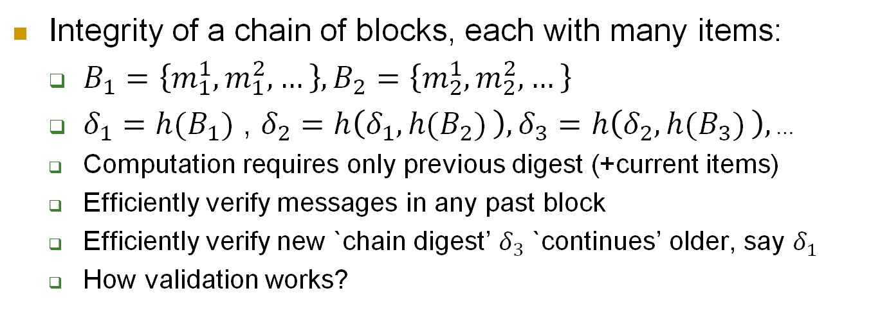








Blockchain:
Integrity of a chain of blocks, each with many items:
$B_{1}=\left\{m_{1}^{1},m_{1}^{2},…\right\}, B_{2}=\left\{m_{2}^{1},m_{2}^{2},…\right\}$
$δ_{1}=h(B_{1})$ , $δ_{2}=h\left(δ_{1},h(B_{2}) \right),δ_{3}=h\left(δ_{2},h(B_{3}) \right),$ …
Computation requires only previous digest (+current items)
Efficiently verify messages in any past block
Efficiently verify new `chain digest’ $δ_{3}$ `continues’ older, say $δ_{1}$
How validation works?
$$B_{1}=\left\{m_{1}^{1},m_{1}^{2},…\right\}$$
$$B_{2}=\left\{m_{2}^{1},m_{2}^{2},…\right\}$$
$$B_{3}=\left\{m_{3}^{1},m_{3}^{2},…\right\}$$
$$h$$
$$h$$
$$h$$
$$h(B_{1})$$
$$h(B_{2})$$
$$h(B_{3})$$
$$δ_{2}$$
$$δ_{3}$$
$$δ_{1}$$
$$h$$
$$h$$

Slide 30


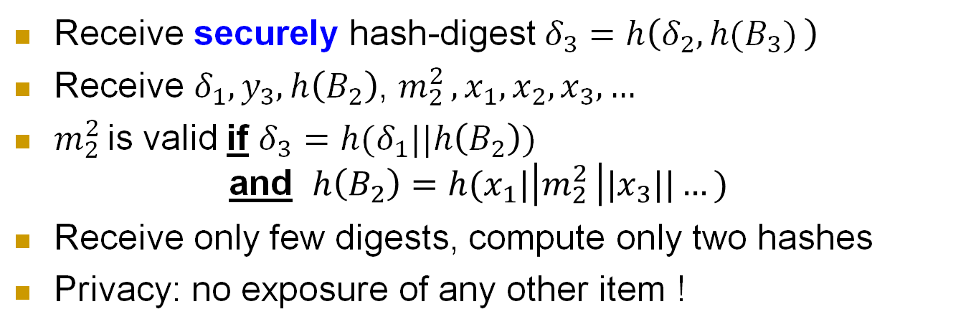








Blockchain validation of item $m_{2}^{2}$:
Receive securely hash-digest $δ_{3}=h\left(δ_{2},h(B_{3}) \right)$
Receive $δ_{1},y_{3},h\left(B_{2}\right)$, $m_{2}^{2 },x_{1},x_{2},x_{3},…$
$m_{2}^{2 }$is valid if $δ_{3}=h(δ_{1}||h\left(B_{2}\right))$ and $h\left(B_{2}\right)=h(x_{1}|\left|m_{2}^{2 }\right||x_{3}||…)$
Receive only few digests, compute only two hashes
Privacy: no exposure of any other item !
$$m_{2}^{2}$$
$$x_{1}$$
$$h$$
$$x_{3},x_{4},…$$
$$h$$
$$h(B_{2})$$
$$y_{3}$$
$$δ_{2}$$
$$δ_{3}$$
$$δ_{1}$$
$$h$$
$$h$$

Slide 31

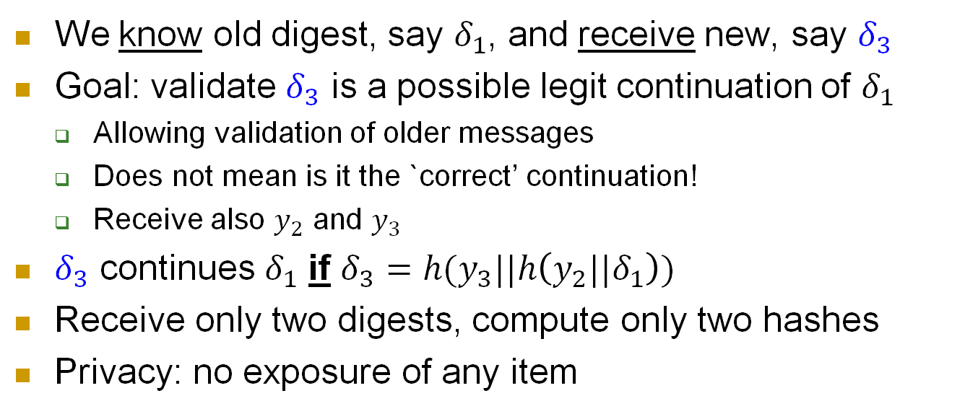





Validation of new digest $δ_{3}$:
We know old digest, say $δ_{1}$, and receive new, say $δ_{3}$
Goal: validate $δ_{3}$ is a possible legit continuation of $δ_{1}$
Allowing validation of older messages
Does not mean is it the `correct’ continuation!
Receive also $y_{2}$ and $y_{3}$
$δ_{3}$ continues $δ_{1}$ if $δ_{3}=h(y_{3}||h\left(y_{2}||δ_{1}\right))$
Receive only two digests, compute only two hashes
Privacy: no exposure of any item
$$y_{2}$$
$$y_{3}$$
$$δ_{2}$$
$$δ_{3}$$
$$δ_{1}$$
$$h$$
$$h$$

Slide 32
VIL CRHF from FIL CRHF
Recall: design and cryptanalyze simple (FIL) function, use it to construct strong (VIL) function
Build VIL CRHF {0,1}*→{0,1}^{n} from FIL CRHF (aka compression function) comp:{0,1}^{n’}→{0,1}^{n}
E.g. n’=2n , i.e. comp:{0,1}^{2n}→{0,1}^{n}
Two main constructions:
MD - Merkle-Damgard (later)
Merkle hash-tree (next)
x₁∈{0,1}^{n}
comp
comp(x₁,x₂)∈{0,1}^{n}
x₂∈{0,1}^{n}
Notes:
32
(c) Amir Herzberg, http://AmirHerzberg.com, Bar Ilan University
04/07/06

Slide 33



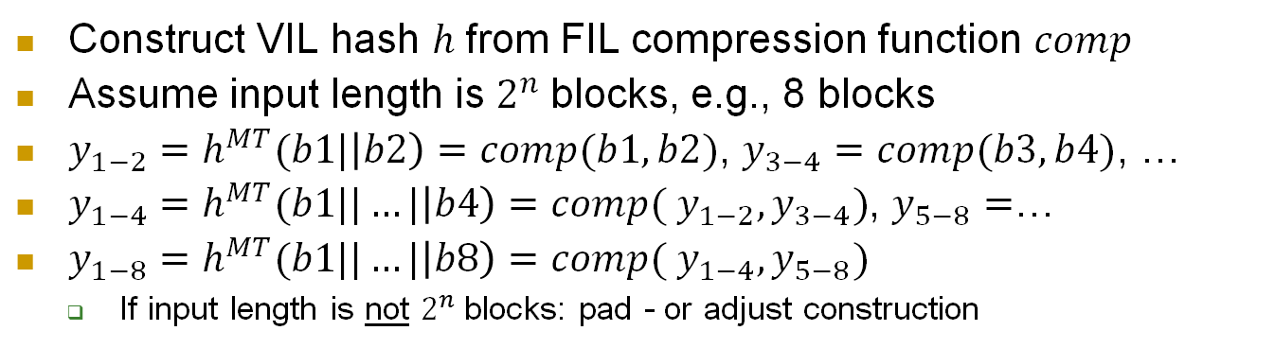

















The Merkle Hash Tree Construction
Construct VIL hash $h$from FIL compression function $comp$
Assume input length is $2^{n}$blocks, e.g., 8 blocks
$y_{1−2}=h^{MT}(b1|\left|b2\right)=comp(b1, b2)$, $y_{3−4}=comp(b3, b4)$, …
$y_{1−4}=h^{MT}(b1||…|\left|b4\right)=comp({ y}_{1−2},y_{3−4})$, $y_{5−8}=$…
$y_{1−8}=h^{MT}(b1||…|\left|b8\right)=comp({ y}_{1−4},y_{5−8})$
If input length is not $2^{n}$blocks: pad - or adjust construction
$$b1$$
$$b2$$
$$b3$$
$$b4$$
$$b5$$
$$b6$$
$$b7$$
$$b8$$
$$comp$$
$$comp$$
$$comp$$
$$comp$$
$$y_{12}$$
$$y_{34}$$
$$y_{56}$$
$$y_{78}$$
$$comp$$
$$comp$$
$$y_{14}$$
$$y_{58}$$
$$comp$$
$h^{MT}(b1||…|\left|b8\right)=comp(y_{14},$ $y_{58}$)
Notes:
33
(c) Amir Herzberg, http://AmirHerzberg.com, Bar Ilan University
04/07/06

Slide 34











The Merkle Hash Tree Construction
$$b1$$
$$b2$$
$$b3$$
$$b4$$
$$b5$$
$$b6$$
$$b7$$
$$b8$$
$$comp$$
$$comp$$
$$comp$$
$$comp$$
$$y_{12}$$
$$y_{34}$$
$$y_{56}$$
$$y_{78}$$
$$comp$$
$$comp$$
$$y_{14}$$
$$y_{58}$$
$$comp$$
$h^{MT}(b1||…|\left|b8\right)=comp(y_{14},$ $y_{58}$)
Notes:
34
(c) Amir Herzberg, http://AmirHerzberg.com, Bar Ilan University
04/07/06

Slide 35














Merkle-Tree: Efficiency and Privacy Applications
$$m1$$
$$m2$$
$$m3$$
$$m4$$
$$m5$$
$$m6$$
$$m7$$
$$m8$$
$$h$$
$$h$$
$$h$$
$$h$$
$$y_{12}$$
$$y_{34}$$
$$y_{56}$$
$$y_{78}$$
$$h$$
$$h$$
$$y_{14}$$
$$y_{58}$$
Often used with standard, VIL hash rather than FIL hash (compression function)
➔ Efficiency and Privacy
$$h$$
$$y_{14}=h^{MT}(m1||…||m8)$$
Each input `block’ is now a message or file. To validate authenticity of one/some, say m5 and m6, it suffices to provide (depth-1) results of hashs (`branch’), e.g.: y78, y14
Notes:
35
(c) Amir Herzberg, http://AmirHerzberg.com, Bar Ilan University
04/07/06

Slide 36












Privacy&Efficiency w/ Merkle Tree
$$m1$$
$$m2$$
$$m3$$
$$m4$$
$$m5$$
$$m6$$
$$m7$$
$$m8$$
$$h$$
$$h$$
$$h$$
$$h$$
$$y_{12}$$
$$y_{34}$$
$$y_{56}$$
$$y_{78}$$
$$h$$
$$h$$
$$y_{14}$$
$$y_{58}$$
$$h$$
$$y_{18}=h^{MD}(m1||…|\left|m8\right)=h(y_{14}||y_{58})$$
Notes:
36
(c) Amir Herzberg, http://AmirHerzberg.com, Bar Ilan University
04/07/06

Slide 37
MD: VIL CRHF from FIL CRHF
The Merkle-Damgard construction of VIL from FIL CRHF
1st Idea: use iterative process, compressing block by block
Let the input x=x[0]||x[1]||… where |x[i]|=L
Pad the last block if necessary [how? how to remove? later…]
For i=0,1,..l, let y_{i}=c(x[i],y_{i-1}); output h(x)=y_{l+1}
Is this CRHF?
No: h(x[0]||x[1]||…||x[l])=h(y₁||x[2]||..x[l])
x[1]
x[2]
…
x[l]
x[0]
c
c
c
h(x)=y_{l}=c(x[l],y_{l-1})
y₁
y₂=c(x[2],y₁)
Notes:
37
(c) Amir Herzberg, http://AmirHerzberg.com, Bar Ilan University
04/07/06

Slide 38
VIL CRHF from FIL CRHF: adding IV
Build VIL CRHF h:{0,1}*→{0,1}^{L} from FIL CRHF c:{0,1}^{2L}→{0,1}^{L}
1st Idea: use iterative process, compressing block by block
2nd idea: use a fixed IV as first block y₀=IV ∈{0,1}^{L}
Let the input x=x[1]||…x[l] where |x[i]|=L
For i=1,..l, let y_{i}=c(x[i],y_{i-1}); output h(x)=y_{l}
Suppose h(x)=h(x’), x≠x’:
If |x|=|x’| ➔ c(x[i],y_{i-1})=c[x’[i],y’_{i-1}) for <x[i],y_{i-1})>≠<x’[i],y’_{i-1}>
What if |x|>|x’| ?
x[1]
x[2]
…
x[l]
h(x)=y_{l}=c(x[l],y_{l-1})
IV=y₀
c
c
c
y₁
y₂=c(x[2],y₁)
Notes:
38
(c) Amir Herzberg, http://AmirHerzberg.com, Bar Ilan University
04/07/06

Slide 39
Merkle - Damgard Length-Padding
Aka Merkle - Damgard Strengthening
Let pad(x)=1||0^{k}||bin (|x|) ; x’=x||pad(x)
Where bin (|x|) is the L–bit binary representation of |x|
And: |x|+|pad(x)|≡0 mod L
Simplify: assume |x|≡0 mod L, |pad(x)|=L
Let y₀=IV be some fixed L bits (IV=Initialization Value)
For i=1,..|x’|/L let y_{i}=c(x’[i],y_{i-1})
Output MD[c]_{IV}(x)=y_{l+1}
Given h(x)=h(x’), for x≠x’, we can find two pairs (a,b)≠ (a’,b’) s.t. c(a,b)=c(a’,b’).
x[1]
x[2]
…
x[l]||10^{k}
bin(|x|)
IV
c
c
c
c
h(x)=y_{l+1}=c(|x|,y_{l})
Notes:
39
(c) Amir Herzberg, http://AmirHerzberg.com, Bar Ilan University
04/07/06

Slide 40
Security of MD Strengthening
x[1]
x[2]
…
x[ ]
|x|
IV
c
c
c
c
h(x)=h(x’)
y₂
Theorem (simplified): if c is CRHF, then h=MD[c] is CRHF.
Proof (sketch): we use collision in h to find collision in c. Suppose h(x)=h(x’) for x≠x’.
h(x)=c(|x| || y_{|x|})= c(|x’| || y’_{|x’|}). Hence assume |x|=|x’| and y_{|x|}= y’_{|x’|} (or collision in c).
Recursively for j=l to 1, we have y_{j}=y’_{j}, i.e. c(x[j]||y_{j-1})=c (x’[j]||y’_{j-1}). Hence x[j]=x’[j] and y_{j-1}=y’_{j-1}. But x≠x’ ! █
Notes:
40
(c) Amir Herzberg, http://AmirHerzberg.com, Bar Ilan University
04/07/06

Slide 41
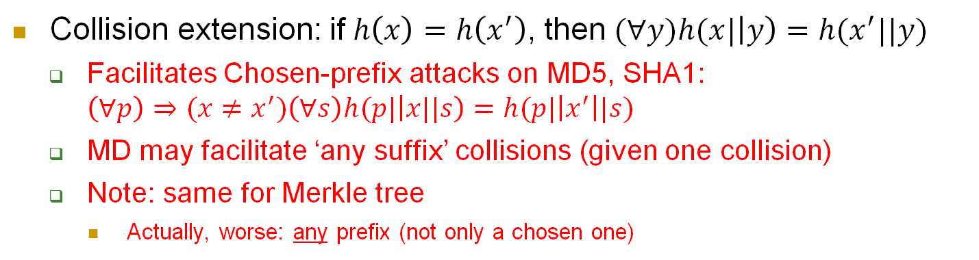
Merkle – Damgard: Collision extension
Collision extension: if$h\left(x\right)=h\left(x^{′}\right)$, then $(∀y)h(x|\left|y\right)=h(x^{′}||y)$
Facilitates Chosen-prefix attacks on MD5, SHA1: $\left(∀p\right)⇒(x≠x^{′})\left(∀s\right)h(p|\left|x||s\right)=h(p|\left|x^{′}\right||s)$
MD may facilitate ‘any suffix’ collisions (given one collision)
Note: same for Merkle tree
Actually, worse: any prefix (not only a chosen one)
x[1]
x[2]
…
x[l]||10^{k}
|x|
IV
c
c
c
c
h(x)=y_{l+1}=c(|x|,y_{l})
Notes:
41
(c) Amir Herzberg, http://AmirHerzberg.com, Bar Ilan University
04/07/06

Slide 42
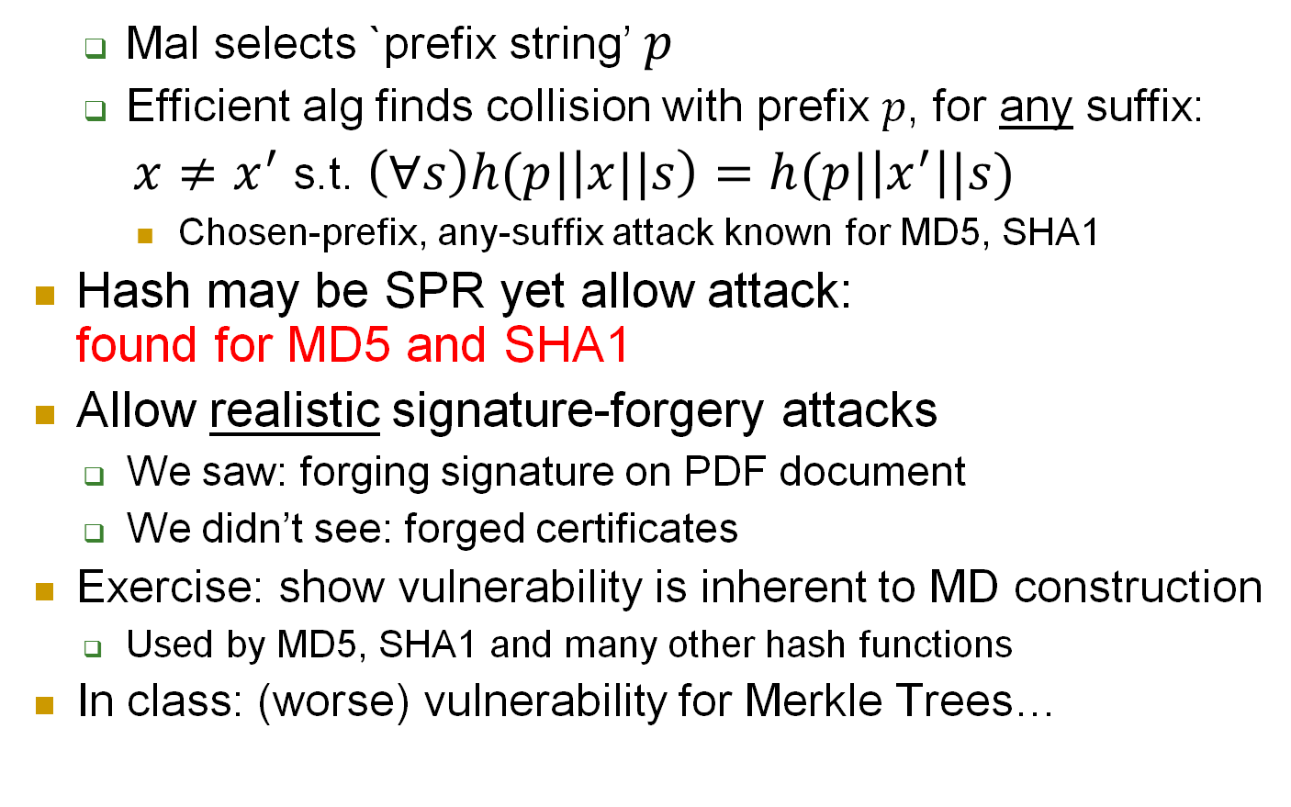
Recall: Chosen-prefix, any suffix vulnerability
Mal selects `prefix string’ $p$
Efficient alg finds collision with prefix $p$, for any suffix:
$x≠x^{′}$ s.t. $\left(∀s\right)h(p|\left|x||s\right)=h(p|\left|x^{′}\right||s)$
Chosen-prefix, any-suffix attack known for MD5, SHA1
Hash may be SPR yet allow attack: found for MD5 and SHA1
Allow realistic signature-forgery attacks
We saw: forging signature on PDF document
We didn’t see: forged certificates
Exercise: show vulnerability is inherent to MD construction
Used by MD5, SHA1 and many other hash functions
In class: (worse) vulnerability for Merkle Trees…
Notes:
42
(c) Amir Herzberg, http://AmirHerzberg.com, Bar Ilan University
04/07/06

Slide 43

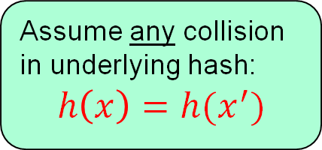
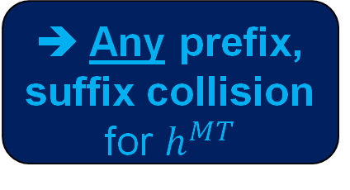
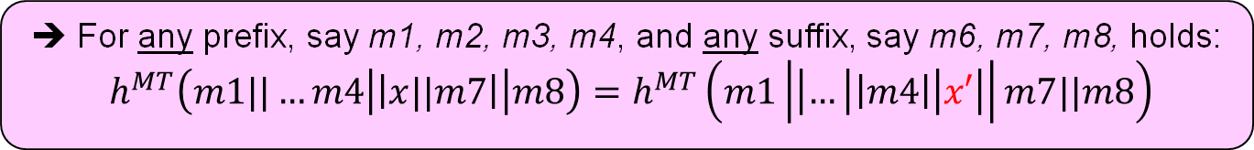
Any prefix/suffix collision attack on Merkle Tree
$$m1$$
$$m2$$
$$m3$$
$$m4$$
$$x/x′$$
$$m7$$
$$m8$$
$$h$$
$$h$$
$$h$$
$$h$$
$$y_{12}$$
$$y_{34}$$
$$y_{56}$$
$$y_{78}$$
$$h$$
$$h$$
$$y_{14}$$
$$y_{58}$$
Assume any collision in underlying hash: $$h\left(x\right)=h(x^{′})$$
➔ Any prefix, suffix collision for $h^{MT}$
$$h$$
$$y_{14}=h^{MT}(m1||…||m8)$$
➔ For any prefix, say m1, m2, m3, m4, and any suffix, say m6, m7, m8, holds: $h^{MT}\left(m1||…m4\left|\left|x||m7\right|\right|m8\right)=h^{MT}\left(m1\left|\left|…\left|\left|m4\right|\right|x′\right|\right|m7||m8\right)$
Notes:
43
(c) Amir Herzberg, http://AmirHerzberg.com, Bar Ilan University
04/07/06

Slide 44




Any prefix/suffix attack on Merkle Tree
$$b1$$
$$b2$$
$$b3$$
$$b4$$
$$x/x′$$
$$b6$$
$$b7$$
$$b8$$
$$comp$$
$$comp$$
$$comp$$
$$comp$$
$$y_{12}$$
$$y_{34}$$
$$y_{56}$$
$$y_{78}$$
$$comp$$
$$comp$$
$$y_{14}$$
$$y_{58}$$
$$comp$$
$$y_{14}=h(b1||…||b8)$$
Notes:
44
(c) Amir Herzberg, http://AmirHerzberg.com, Bar Ilan University
04/07/06

Slide 45
Pseudo-collisions
Question: does reverse hold, i.e.: (MD[c] is CRHF)➔ (c is CRHF) ?
Collision for compression function c is called pseudo-collision for the hash MD[c]
Collision (for MD[c]) from pseudo-collision (for compression function) c?
Not always.
If FIL CRHF exist, then exists c which is not CRHF but MD[c] is CRHF [Prove yourself!]
Intuition: think of 1-block messages: c(x,y)=c(x’,y’). But h(x)=c(x,IV)≠c(x’,IV)=h(x’)!
Nice property of MD… may not hold for other FIL2VIL hash constructions, e.g Merkle Tree

Slide 46
Crypto-Hash functions
Introduction to cryptographic hash
Integrity: collision-resistance and blockchains
Hash h(m) allows verification of m
Confidentiality: one-way functions (OWF)
OWF-hash h(m) does not expose m
And: Proof-of-Work (PoW)
Pseudo-randomness
If m contains some random bits, then h(m) is (pseudo)random
Notes:
Today’s I will introduce you to the topic of cryptography for blockchains; unfortunately I will not be able to stay for the rest of the days of this workshop but I believe you will find this to provide important background to the more advanced topics that will be covered in the later days. Cryptography, you know, is in Greek, and initially referred to incomprehensible, cryptic communication; I will do my best to make sure that what I present will not be too cryptic and you will be able to understand, however, please help me by asking many questions whenever something is not clear. Specifically, we focus on the cryptographic tools used for blockchains, which are mostly public key signatures and cryptographic hash functions. These are non-trivial and somewhat technical topics, but if we work hard together, I hope that at the end of the day you will understand them quite well, and they will not be a hash of concepts but clear tools, ready for use in the rest of this week and in the future. We will have four parts or blocks to this day. In the first block, we will discuss crypto-hash functions and introduce blockchains from the cryptographic point of view. In the second block, we introduce a bit more crypto and discuss pk-sign and crhf. In the third block, we discuss other important properties of crypto hash, beyond crhf. Finally, our last lecture will attempt to connect all these blocks and wrap up the topic of crypto and hashing for blockchains.

Slide 47



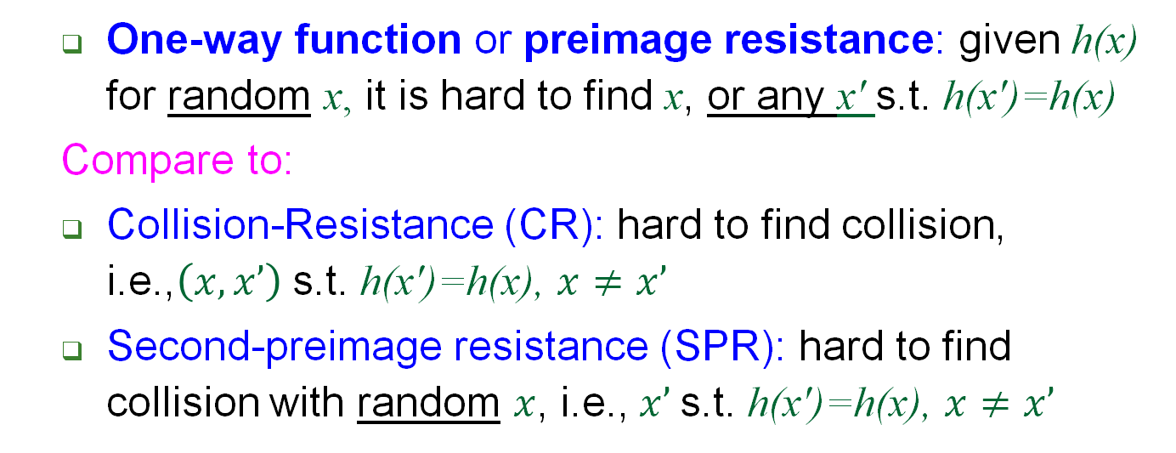



One-Way Function (OWF)
$h\left(x\right)$ (random $x$)
Domain ${\left\{0,1\right\}}^{∗}$
Hash function $h\left(∙\right)$
Range ${\left\{0,1\right\}}^{n}$
Adversary
$$x∘$$
$$x′∘$$
$$∘h\left(x\right)=h(x^{′})$$
$x’$ (or $x$)
Hard
One-way function or preimage resistance: given h(x) for random x, it is hard to find x, or any x' s.t. h(x')=h(x)
Compare to:
Collision-Resistance (CR): hard to find collision, i.e.,$\left(x,x’\right)$ s.t. h(x')=h(x), $x≠x’$
Second-preimage resistance (SPR): hard to find collision with random $x$, i.e.,$x’$ s.t. h(x')=h(x), $x≠x’$
Notes:
47
(c) Amir Herzberg, http://AmirHerzberg.com, Bar Ilan University
04/07/06
CR>SPR [and SPR<OWF if |domain|>>|range|
Which property is required for signatures? For deriving DH/El-gamal keys?

Slide 48
Exercise
Let be h₁, h₂ be both CRHF and OWF
Use them to construct:
h_{CRHF} - CRHF but not OWF
h_{OWF} - OWF but not CRHF
Solution:
h_{CRHF} =
h_{OWF} =

Slide 49
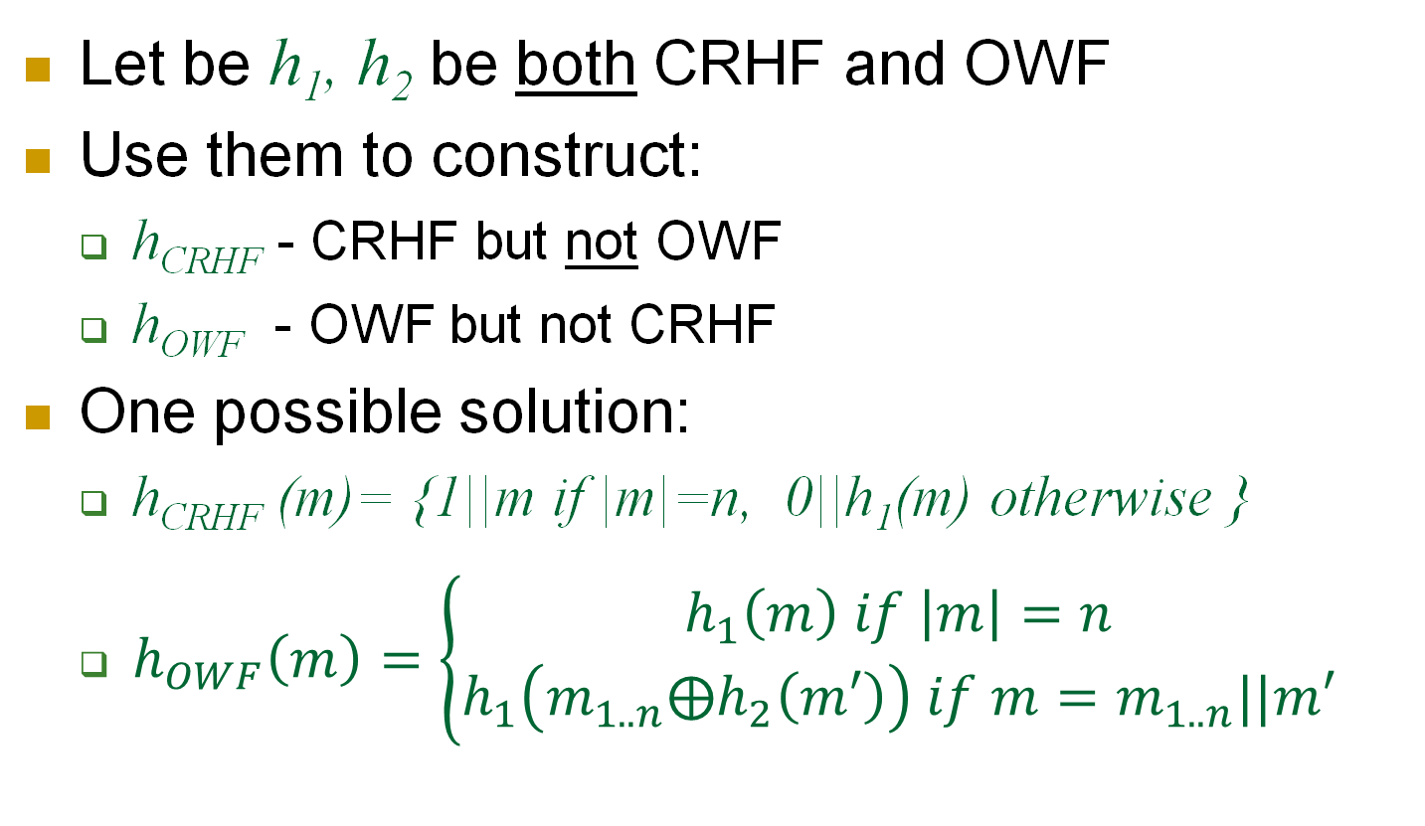
Exercise
Let be h₁, h₂ be both CRHF and OWF
Use them to construct:
h_{CRHF} - CRHF but not OWF
h_{OWF} - OWF but not CRHF
One possible solution:
h_{CRHF} (m)= {1||m if |m|=n, 0||h₁(m) otherwise }
$h_{OWF}\left(m\right)=\left\{\begin{aligned}h_{1}\left(m\right) if \left|m\right|=n \\ h_{1}\left({m_{1..n}⨁h}_{2}\left(m′\right)\right) if m=m_{1..n}||m′\end{aligned}\right.$

Slide 50
OWF Application: One-time PW
$h\left(x\right)$ (random $x$)
Domain ${\left\{0,1\right\}}^{∗}$
Hash function $h\left(∙\right)$
Range ${\left\{0,1\right\}}^{n}$
Adversary
$$x∘$$
$$x′∘$$
$$∘h\left(x\right)=h(x^{′})$$
$x’$ (or $x$)
Hard
One-way function (aka preimage resistance): given h(x) for random x, it is hard to find x, or any x' s.t. h(x')=h(x)
One-time password authentication:
Select random x : ‘one-time password’ (keep secret!)
Validate using non-secret ‘one-time validation token’: h(x)
Extend to one-time signatures…
Notes:
50
(c) Amir Herzberg, http://AmirHerzberg.com, Bar Ilan University
04/07/06
CR>SPR [and SPR<OWF if |domain|>>|range|
Which property is required for signatures? For deriving DH/El-gamal keys?

Slide 51






OWF-based One-Time Signing
One-time signature scheme – for single bit b message:
Private key: two random ‘one-time PWs’: s₀ , s₁
Public key: two strings v₀=h(s₀), v₁=h(s₁)
Signature: to sign bit b send signature $σ=S_{(s_{0},s_{1})}\left(b\right)=s_{b}$
Validate: $V_{(v_{0},v_{1})}\left(b,σ\right)=\left\{1 if v_{b}=h\left(σ\right), 0 else\right\}$
How to extend to a (one-time) signatures for any string ?
Key Generation
Private key: s₀ , s₁← $
Public key: v₀=h(s₀), v₁=h(s₁)
$$b$$
$$σ=s_{b}$$
Sign: $σ=S_{(s_{0},s_{1})}\left(b\right)=s_{b}$
Verify: is v_{b}=h($σ$) ?
$Yes$→Valid
Notes:
51
(c) Amir Herzberg, http://AmirHerzberg.com, Bar Ilan University
04/07/06
CR>SPR [and SPR<OWF if |domain|>>|range|
Which property is required for signatures? For deriving DH/El-gamal keys?

Slide 52

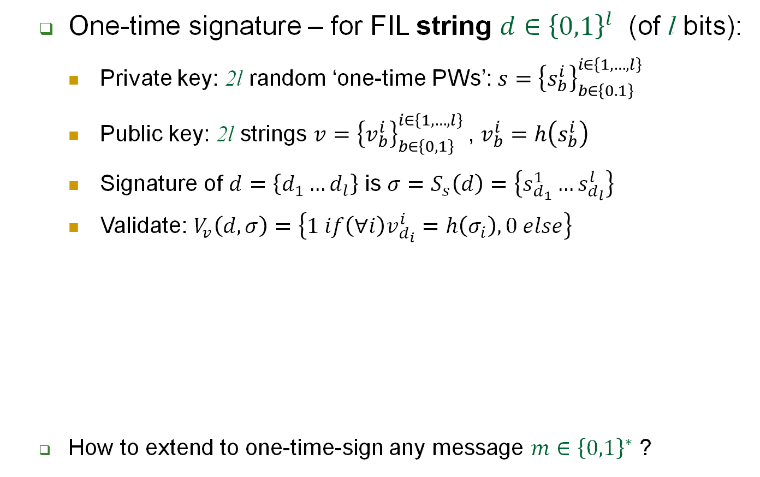








FIL One-Time Signing
One-time signature – for FIL string $d∈{\left\{0,1\right\}}^{l}$ (of l bits):
Private key: 2l random ‘one-time PWs’: $s={\left\{s_{b}^{i}\right\}}_{b∈\left\{0.1\right\}}^{i∈\left\{1,…,l\right\}}$
Public key: 2l strings ${v={\left\{v_{b}^{i}\right\}}_{b∈\left\{0,1\right\}}^{i∈\left\{1,…,l\right\}}}_{ }^{ }$, $v_{b}^{i}=h\left(s_{b}^{i}\right)$
Signature of $d=\left\{d_{1}…d_{l}\right\}$ is $σ=S_{s}\left(d\right)=\left\{s_{d_{1}}^{1}…s_{d_{l}}^{l}\right\}$
Validate: $V_{v}\left(d,σ\right)=\left\{1 if\left(∀i\right)v_{d_{i}}^{i}=h\left(σ_{i}\right), 0 else\right\}$
How to extend to one-time-sign any message $m∈{\left\{0,1\right\}}^{∗}$ ?
Key Generation
Private key: ${s=\left\{s_{b}^{i}\right\}}_{b∈\left\{0,1\right\}}^{i∈\left\{1,…,l\right\}}$← $
Public key: $v={\left\{v_{b}^{i}\right\}}_{b∈\left\{0,1\right\}}^{i∈\left\{1,…,l\right\}} , v_{b}^{i}=h\left(s_{b}^{i}\right)$
$$s$$
$$v$$
$$d$$
$$σ$$
Sign: $σ=S_{s}\left(d\right)=\left\{s_{d_{1}}^{1}…s_{d_{l}}^{l}\right\}$
Verify: is $v_{d_{i}}^{i}$=h($σ_{i}$) ?
$Yes$→Valid
Notes:
52
(c) Amir Herzberg, http://AmirHerzberg.com, Bar Ilan University
04/07/06
CR>SPR [and SPR<OWF if |domain|>>|range|
Which property is required for signatures? For deriving DH/El-gamal keys?

Slide 53
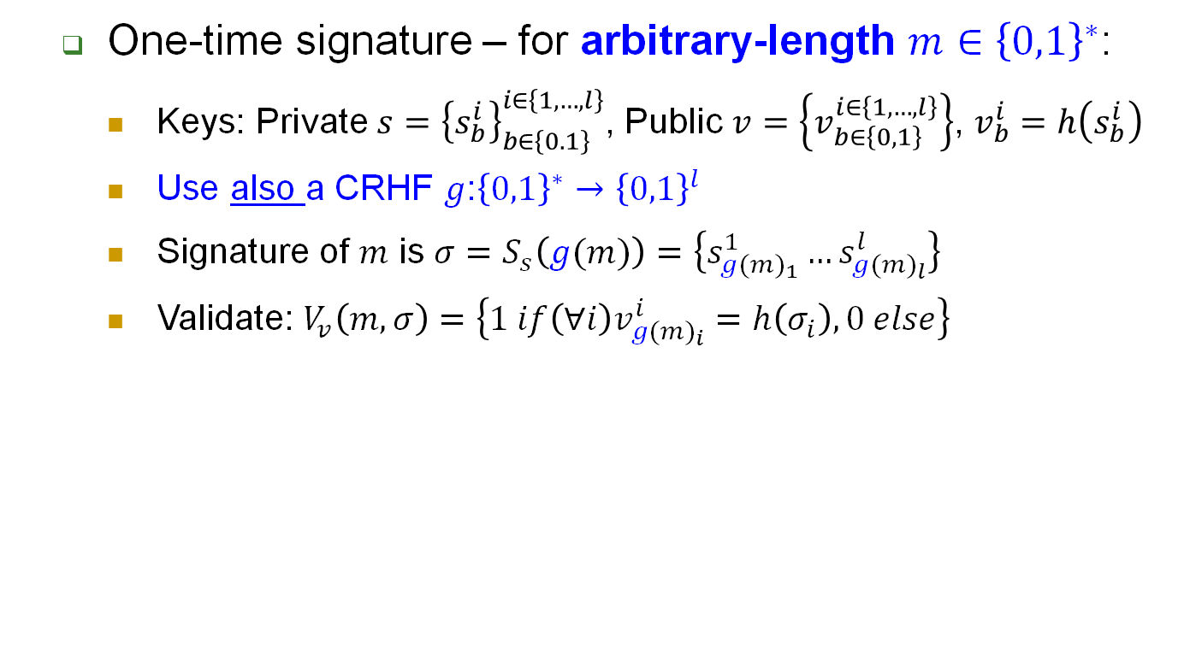





One-Time Signing: any string (VIL)
One-time signature – for arbitrary-length $m∈{\left\{0,1\right\}}^{∗}$:
Keys: Private $s={\left\{s_{b}^{i}\right\}}_{b∈\left\{0.1\right\}}^{i∈\left\{1,…,l\right\}}$, Public $v=\left\{v_{b∈\left\{0,1\right\}}^{i∈\left\{1,…,l\right\}}\right\}$, $v_{b}^{i}=h\left(s_{b}^{i}\right)$
Use also a CRHF $g$:${\left\{0,1\right\}}^{∗}→{\left\{0,1\right\}}^{l}$
Signature of $m$ is $σ=S_{s}\left(g(m)\right)=\left\{s_{{g(m)}_{1}}^{1}…s_{{g(m)}_{l}}^{l}\right\}$
Validate: $V_{v}\left(m,σ\right)=\left\{1 if\left(∀i\right)v_{{g(m)}_{i}}^{i}=h\left(σ_{i}\right), 0 else\right\}$
Key Generation
Private key: ${s=\left\{s_{b}^{i}\right\}}_{b∈\left\{0.1\right\}}^{i∈\left\{1,…,l\right\}}$← $
Public key: $v={\left\{v_{b}^{i}\right\}}_{b∈\left\{0.1\right\}}^{i∈\left\{1,…,l\right\}} , v_{b}^{i}=h\left(s_{b}^{i}\right)$
$$s$$
$$v$$
$$m$$
$$σ$$
Sign: $σ=S_{s}\left(g(m)\right)$
Verify: is $v_{{g(m)}_{i}}^{i}$=h($σ_{i}$) ?
$Yes$→Valid
Exercise: change to use short (n-bit) public key!
Notes:
53
(c) Amir Herzberg, http://AmirHerzberg.com, Bar Ilan University
04/07/06
CR>SPR [and SPR<OWF if |domain|>>|range|
Which property is required for signatures? For deriving DH/El-gamal keys?

Slide 54
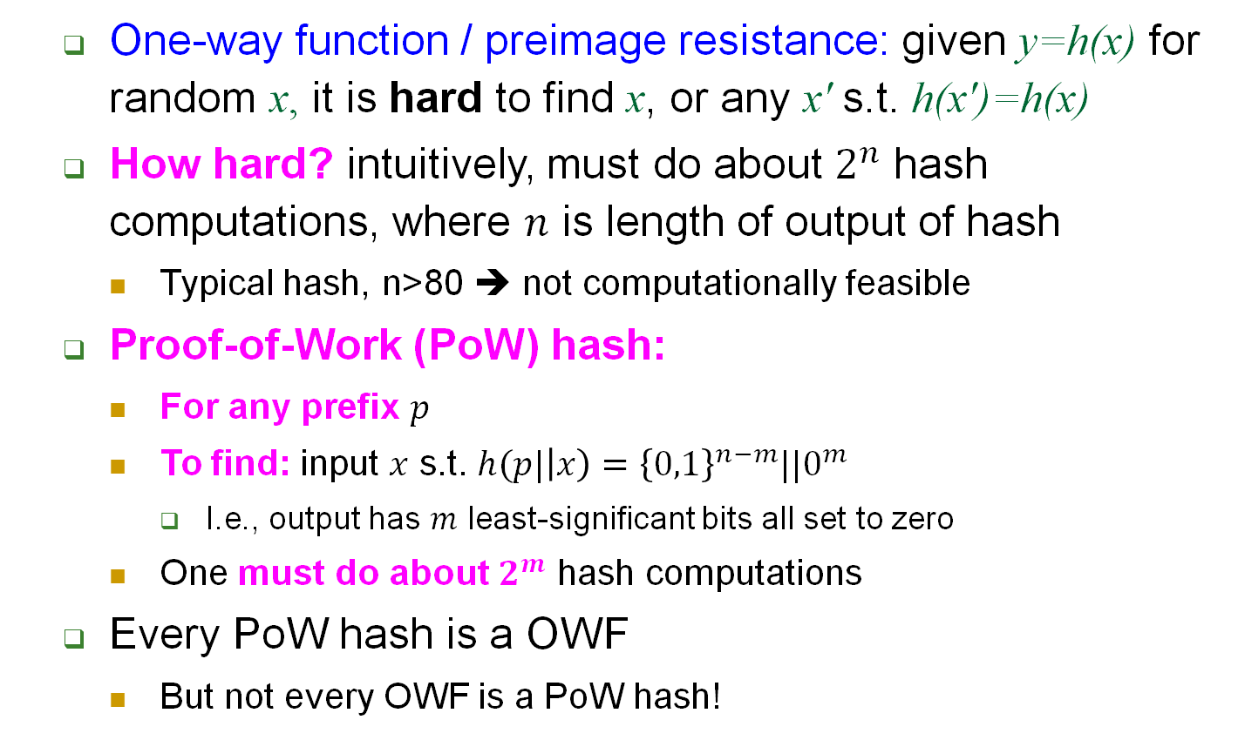
From OWF to Proof-of-Work
One-way function / preimage resistance: given y=h(x) for random x, it is hard to find x, or any x' s.t. h(x')=h(x)
How hard? intuitively, must do about $2^{n}$ hash computations, where $n$ is length of output of hash
Typical hash, n>80 ➔ not computationally feasible
Proof-of-Work (PoW) hash:
For any prefix $p$
To find: input $x$ s.t. $h(p|\left|x\right)={{\left\{0,1\right\}}^{n−m}||0}^{m}$
I.e., output has $m$ least-significant bits all set to zero
One must do about $2^{m}$ hash computations
Every PoW hash is a OWF
But not every OWF is a PoW hash!
Notes:
54
(c) Amir Herzberg, http://AmirHerzberg.com, Bar Ilan University
04/07/06
CR>SPR [and SPR<OWF if |domain|>>|range|
Which property is required for signatures? For deriving DH/El-gamal keys?

Slide 55
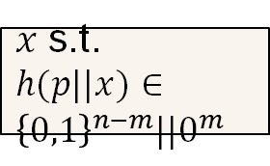
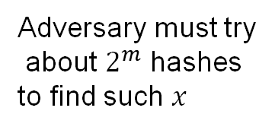

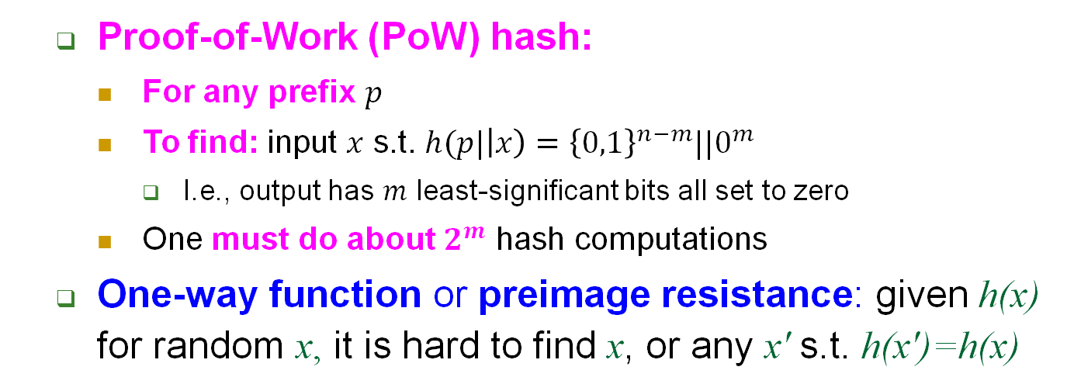
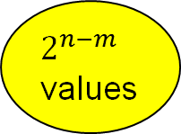
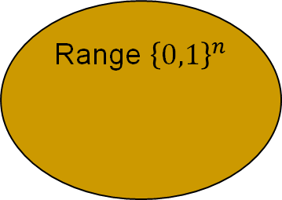

Proof-of-Work (PoW) Hash
$$p, m$$
Adversary must try
about $2^{m}$ hashes
to find such $x$
Domain ${\left\{0,1\right\}}^{∗}$
Range ${\left\{0,1\right\}}^{n}$
Adversary
$$p||x∘$$
$2^{n−m}$ values
$x$ s.t. $h(p||x)∈{{\left\{0,1\right\}}^{n−m}||0}^{m}$
Hard
Proof-of-Work (PoW) hash:
For any prefix $p$
To find: input $x$ s.t. $h(p|\left|x\right)={{\left\{0,1\right\}}^{n−m}||0}^{m}$
I.e., output has $m$ least-significant bits all set to zero
One must do about $2^{m}$ hash computations
One-way function or preimage resistance: given h(x) for random x, it is hard to find x, or any x' s.t. h(x')=h(x)
Notes:
55
(c) Amir Herzberg, http://AmirHerzberg.com, Bar Ilan University
04/07/06
CR>SPR [and SPR<OWF if |domain|>>|range|
Which property is required for signatures? For deriving DH/El-gamal keys?

Slide 56
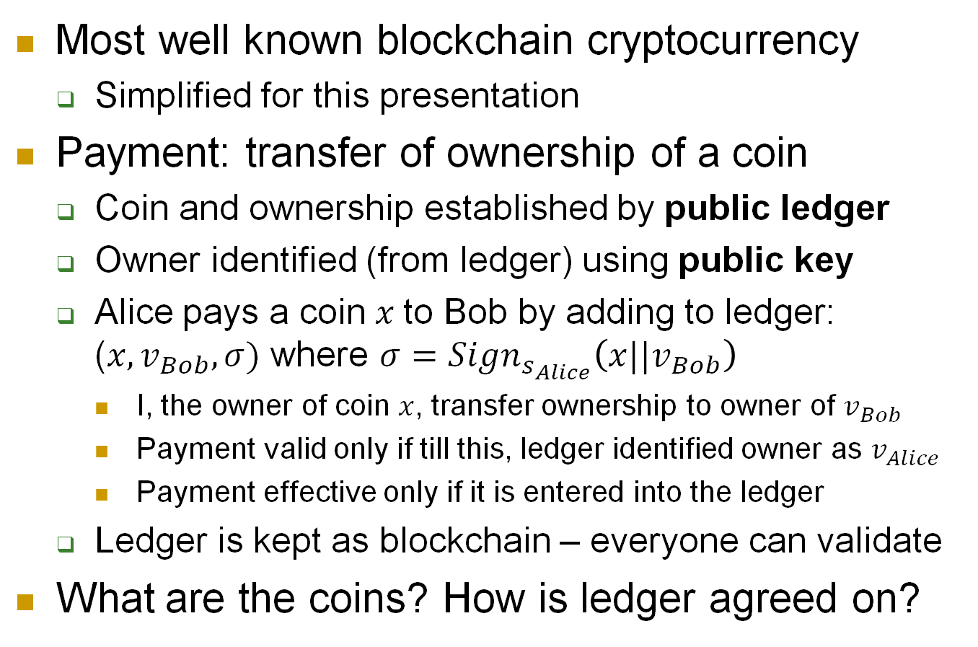
Using crypto-hash… in BitCoin?
Most well known blockchain cryptocurrency
Simplified for this presentation
Payment: transfer of ownership of a coin
Coin and ownership established by public ledger
Owner identified (from ledger) using public key
Alice pays a coin $x$to Bob by adding to ledger: ($x,v_{Bob},σ)$ where $σ={Sign}_{s_{Alice}}\left(x||v_{Bob}\right)$
I, the owner of coin $x$, transfer ownership to owner of $v_{Bob}$
Payment valid only if till this, ledger identified owner as $v_{Alice}$
Payment effective only if it is entered into the ledger
Ledger is kept as blockchain – everyone can validate
What are the coins? How is ledger agreed on?

Slide 57










BitCoin: Ledger, Coins, Mining
Ledger is a blockchain
Items in block: payment transactions
➔Everyone can validate payments occurred
And trace ownership of every coin
Blocks are appended by mining a new coin
Democratic: everyone may mine coins, append block!
Only… must solve Proof-of-Work: $m$ Least-significant-bits of each block-hash ($δ_{1}$, $δ_{2}$, $δ_{3}$) must be zero !
$$B_{1}=\left\{m_{1}^{1},m_{1}^{2},…\right\}$$
$$B_{2}=\left\{m_{2}^{1},m_{2}^{2},…\right\}$$
$$B_{3}=\left\{m_{3}^{1},m_{3}^{2},…\right\}$$
$$h$$
$$h$$
$$h$$
$$h(B_{1})$$
$$h(B_{2})$$
$$h(B_{3})$$
$$δ_{2}$$
$$δ_{3}$$
$$δ_{1}$$
$$h$$
$$h$$

Slide 58







Wait: how is miner getting his coin?
Miner appending his new coin to the block!
New coin, say to block $i$, is a pair $(v_{i},r_{i})$:
($v_{i},$ $s_{i}$) is a public-key signature scheme generated by miner
$r_{i}$ is the coin identifier, selected (randomly) to solve the PoW:
$$h(δ_{i−1}|\left|B_{i}\right)=h\left(δ_{i−1}||h\left(m_{i}^{1},m_{i}^{2},…,(v_{i},r_{i})\right)\right)$$
Allows miner to later pay coin, e.g. to Bob, by adding to ledger: ($r_{i}||v_{Bob},σ)$ where $σ={Sign}_{s_{i}}\left(r_{i}||v_{Bob}\right)$
$$B_{1}=\left\{m_{1}^{1},m_{1}^{2},…,(v_{1},r_{1})\right\}$$
$$B_{2}=\left\{m_{2}^{1},m_{2}^{2},…,(v_{2},r_{2})\right\}$$
$$B_{3}=\left\{m_{3}^{1},m_{3}^{2},…,(v_{3},r_{3})\right\}$$
$$h$$
$$h$$
$$h$$
$$h(B_{1})$$
$$h(B_{2})$$
$$h(B_{3})$$
$$δ_{2}$$
$$δ_{3}$$
$$δ_{1}$$
$$h$$
$$h$$

Slide 59






How hard is it to mine a coin?
Recall Proof-of-Work: $m$ Least-significant-bits of each block-hash, e.g., $δ_{3}$, must be zero
If hash is a secure Proof-of-Work hash, this requires about $2^{m}$ hash computations
Hash functions are efficient, but this can still be a lot…
If too easy➔ coins mined too quickly
Bit-coin auto-adjusts $m$ to maintain rate of mining
Adversary must try
about $2^{m}$ hashes
to find such $x$
m
Domain ${\left\{0,1\right\}}^{∗}$
Range ${\left\{0,1\right\}}^{n}$
Adversary
$$p||x∘$$
$2^{n−m}$ values
$x$ s.t.$h(p||x)∈{{\left\{0,1\right\}}^{n−m}||0}^{m}$
Hard

Slide 60
Crypto-Hash functions
Introduction to cryptographic hash
Integrity: collision-resistance and blockchains
Hash h(m) allows verification of m
Confidentiality: one-way functions (OWF)
OWF-hash h(m) does not expose m
And: Proof-of-Work (PoW)
Pseudo-randomness
If m contains some random bits, then h(m) is (pseudo)random
Notes:
Today’s I will introduce you to the topic of cryptography for blockchains; unfortunately I will not be able to stay for the rest of the days of this workshop but I believe you will find this to provide important background to the more advanced topics that will be covered in the later days. Cryptography, you know, is in Greek, and initially referred to incomprehensible, cryptic communication; I will do my best to make sure that what I present will not be too cryptic and you will be able to understand, however, please help me by asking many questions whenever something is not clear. Specifically, we focus on the cryptographic tools used for blockchains, which are mostly public key signatures and cryptographic hash functions. These are non-trivial and somewhat technical topics, but if we work hard together, I hope that at the end of the day you will understand them quite well, and they will not be a hash of concepts but clear tools, ready for use in the rest of this week and in the future. We will have four parts or blocks to this day. In the first block, we will discuss crypto-hash functions and introduce blockchains from the cryptographic point of view. In the second block, we introduce a bit more crypto and discuss pk-sign and crhf. In the third block, we discuss other important properties of crypto hash, beyond crhf. Finally, our last lecture will attempt to connect all these blocks and wrap up the topic of crypto and hashing for blockchains.

Slide 61

Crypto hash functions: Goals
Collision-Resistance (CR): hard to find collision, i.e.,$\left(x,x’\right)$ s.t. h(x')=h(x), $x≠x’$
One-way function / preimage resistance: given h(x) for random x, it is hard to find x, or any x' s.t. h(x')=h(x)
Proof-of-Work (PoW): it takes about $2^{m}$ hash computations to find $x$ s.t. $h(x)$ has $m$ zero LSbits
PoW resembles another property…
Randomness Extraction: if ‘enough’ of the input bits are random ➔ all $n$ output bits are pseudorandom
Notes:
61
(c) Amir Herzberg, http://AmirHerzberg.com, Bar Ilan University
04/07/06
CR>SPR [and SPR<OWF if |domain|>>|range|
Which property is required for signatures? For deriving DH/El-gamal keys?

Slide 62





Randomness Extraction Goal
Select random bit $b\underset{←}{\$}\{0,1\}$
$y_{b}=h(x$)
$y_{b−1}\underset{←}{\$}{\{0,1\}}^{n}$ (random)
$$\left(y_{0},y_{1}\right)$$
Let $x$be string chosen by adversary, except for $m$ random bits
Adv
Guess $b’$;
Adv wins if $b^{′}=b$
‘If input is sufficiently random, then output is random’
Multiple `sufficiently random’ models
Randomness extraction: if any $m$ input bits are random ➔ all $n$ output bits are pseudorandom
For sufficiently large$m$
Pseudorandom: it is not computationally-feasible to distinguish between these bits and truly random bits
Notes:
62
(c) Amir Herzberg, http://AmirHerzberg.com, Bar Ilan University
04/07/06
CR>SPR [and SPR<OWF if |domain|>>|range|
Which property is required for signatures? For deriving DH/El-gamal keys?

Slide 63





Randomness Extraction Goal (1)
‘If input is sufficiently random, then output is random’
Multiple `sufficiently random’ models
Von Neuman’s: each bit is result of flip of coin with fixed bias
Arrange input in pairs of bits: $\left\{\left(x_{i},y_{i}\right)\right\}$
Remove pairs where bits are the same, so now $x_{i}≠y_{i}$
Output $x_{i}$
Simple model: at least$m$ of the input bits are random
Learn crypto for stronger (& more complex) models, results
Select $b\underset{←}{\$}\{0,1\}$, and the$m$ random bits of $input$. $y_{b}←h(input)$, $y_{b−1}\underset{←}{\$}{\{0,1\}}^{n}$
$$\left(y_{0},y_{1}\right)$$
Adv($1^{n}$): select $input$, except for $m$ (random) bits
Adv
Adv wins if $b^{′}=b$
Notes:
63
(c) Amir Herzberg, http://AmirHerzberg.com, Bar Ilan University
04/07/06
CR>SPR [and SPR<OWF if |domain|>>|range|
Which property is required for signatures? For deriving DH/El-gamal keys?

Slide 64




Randomness Extraction Goal (2)
Select $b\underset{←}{\$}\{0,1\}$, $x′\underset{←}{\$}{\{0,1\}}^{|x|}$
$$y_{b}=h(x⊕\left(x′∧M\right))$$
$$y_{b−1}\underset{←}{\$}{\{0,1\}}^{n}$$
$$\left(y_{0},y_{1}\right)$$
$x,M∈{\{0,1\}}^{∗}←$A($1^{n}$)
$\left|x\right|=\left|M\right|, ΣM\left(i\right)≥m$ (mask $M$has$≤m$ 1 bits)
Adv
Adv wins if $b^{′}=b$
‘If input is sufficiently random, then output is random’
Randomness extraction: if any $m$ input bits are random ➔ all $n$ output bits are pseudorandom
For sufficiently large$m$
Notes:
64
(c) Amir Herzberg, http://AmirHerzberg.com, Bar Ilan University
04/07/06
CR>SPR [and SPR<OWF if |domain|>>|range|
Which property is required for signatures? For deriving DH/El-gamal keys?

Slide 65

KDF: Salted Randomness Extraction
Key Derivation Function (KDF)
Two variants: random-keyed and unkeyed (deterministic)
Randomized - KDF: $k={KDF}_{s}\left(r\right)$ where KDF is a key derivation function, $s$ is public random (‘salt’) and $r$ is `sufficiently random’ input
Deterministic - crypto-hash: $k=h\left(r\right)$ where h is randomness-extracting crypto-hash
No need in salt, but not provably-secure
Question: isn’t (every) PRF a KDF? [not that easy ☺ ]
Note: definition of KDF: see textbook

Slide 66


Crypto hash functions: Goals
Q: Show why $h\left(x\right)=x mod 2^{n}$ fails to meet any of the goals
Questions?
Randomness extraction*: if any$m$ input bits are random ➔ entire output (all $n$ bits) is pseudorandom
One-way function / preimage resistance: given h(x) for random x, it is hard to find x, or any x' s.t. h(x')=h(x)
Second pre-image resistance (SPR): hard to find collision with random $x$, i.e.,$x’$ s.t. h(x')=h(x), $x≠x’$
Collision-Resistance (CR): hard to find collision, i.e.,$\left(x,x’\right)$ s.t. h(x')=h(x), $x≠x’$
Notes:
66
(c) Amir Herzberg, http://AmirHerzberg.com, Bar Ilan University
04/07/06
CR>SPR [and SPR<OWF if |domain|>>|range|
Which property is required for signatures? For deriving DH/El-gamal keys?

Slide 67
Hash based MAC
Hash-based MAC is often faster than block-cipher MAC
How? Heuristic constructions:
MACKM_{k}(m)=h(k||m), MACMK_{k}(m)=h(m||k), MACKMK_{k}(m)=h(k||m||k)…
Are these secure assuming CRHF ? OWF ? Both ?
No – easy examples. Furthermore…
h(k||m) with MD is broken: length extension !
h(m||k) with MD-w/o-length-padding is also broken [ex]
But: all ‘secure in random oracle model’
Notes:
67
(c) Amir Herzberg, http://AmirHerzberg.com, Bar Ilan University
04/07/06

Slide 68
Random Oracle Method
Use a fixed, keyless hash function h
Analyze as if hash h() is a random function
An invalid assumption: h() is fixed!
Whenever h() is used, use oracle (black box) for random function
Good for screening insecure solutions
Random oracle security ➔ many attacks fail
Not proof, but exclude ‘structural weaknesses’
In practice: assume random oracle and use a standard hash functions
Or better: replace by ‘standard’ crypto schemes
Notes:
68
(c) Amir Herzberg, http://AmirHerzberg.com, Bar Ilan University
04/07/06

Slide 69

NMAC: MAC from Keyed Hash
Secure MAC from keyed hash – no ‘random oracle’
NMAC uses:
keyed hash $h$
Two keys: $k_{out}, k_{in}$
Construction: ${NMAC}_{k_{out},k_{in}}=h_{k_{out}}\left(h_{k_{in}}\left(x\right)\right)$
Pro: provable security
Cons: requires keyed crypto hash, two keys
HMAC: a heuristic variant using keyless hash…
Notes:
69
(c) Amir Herzberg, http://AmirHerzberg.com, Bar Ilan University
04/07/06
Heuristic simplification of NMAC, which has a reduction to two assumptions on the hash

Slide 70

Hash-based MAC: HMAC
Goal: a ‘mode’ for (unkeyed) hash function + key
MD-constructed hash function $h$
HMAC uses only the unkeyed hash function $h$:
HMAC_{k}(x)=h(k⊕ opad || h(k ⊕ ipad || x))
Opad, ipad: fixed sequences (of 36x, 5Cx resp.), for max hamming distance btw k ⊕ opad and k ⊕ ipad.
Widely deployed – for MAC, PRF and KDF
KDF – Key Derivation Function
Notes:
70
(c) Amir Herzberg, http://AmirHerzberg.com, Bar Ilan University
04/07/06
Heuristic simplification of NMAC, which has a reduction to two assumptions on the hash

Slide 71
HMAC, NMAC: Usage, Properties
Often faster than block-cipher MAC
Usage:
With secret key: as MAC or PRF
With public key (‘salt’ or ‘nonce’, HMACs(x)), incl.:
Key derivation function (HKDF) – extract randomness
Integrity (hash-then-sign, files) – as keyed hash
Some proven properties (reductions):
CRHF if underlying hash (or compression) is CRHF
Secure VIL-PRF if compression function is FIL-PRF
Secure key-derivation (randomness extraction)
Easy: assuming hash is m-bits randomness-extracting
Also under (some) weaker assumptions
Notes:
71
(c) Amir Herzberg, http://AmirHerzberg.com, Bar Ilan University
04/07/06
Heuristic simplification of NMAC, which has a reduction to two assumptions on the hash

Slide 72

Crypto hash functions: Goals
One-way function / preimage resistance: given h(x) for random x, it is hard to find x, or any x' s.t. h(x')=h(x)
Proof-of-Work (PoW): given ‘target set’ $Y$ of size ${≥2}^{n−m}$, it takes about $2^{m}$ hash computations to find $x$ s.t. $h\left(x\right)∈Y$
Collision-Resistance (CR): hard to find collision, i.e.,$\left(x,x’\right)$ s.t. h(x')=h(x), $x≠x’$
Randomness extraction: if any$m$ input bits are random ➔ entire output (all $n$ bits) is pseudorandom
given y=h(x), let x’=y=h(x) then $h_{LSD}\left(x′\right)=x mod 10$
Same – for any $y∈Y$
Not even weakly-CR; same example as for OWF
Why $h_{LSD}\left(x\right)=x mod 10$ fails to meet each goal?
Let $x∈\{0,1,…9\}$; for any $m$-bit integer $r: h\left(x+10r\right)=h(x)$
Notes:
72
(c) Amir Herzberg, http://AmirHerzberg.com, Bar Ilan University
04/07/06
CR>SPR [and SPR<OWF if |domain|>>|range|
Which property is required for signatures? For deriving DH/El-gamal keys?

Slide 73
Standard crypto hash functions
Standards crypto-hash functions: all keyless
Efficient, free implementations, open spec/standard
Some examples: MD5, SHA-1/2/3, RIPEMD…
Security by failed cryptanalysis
Or not - collisions found in MD5, SHA1, RIPEMD
Requirements in standards:
Collision-Resistance (CR)
And a weaker notion: Second-preimage resistance (SPR)
Preimage resistance, aka One-Way Function (OWF)
Not in standards: PoW, randomness extraction
Notes:
73
(c) Amir Herzberg, http://AmirHerzberg.com, Bar Ilan University
04/07/06
CR>SPR [and SPR<OWF if |domain|>>|range|
Which property is required for signatures? For deriving DH/El-gamal keys?

Slide 74
Standard crypto hash functions
Standards crypto-hash functions: all keyless
Efficient, free implementations, open spec/standard
Some examples: MD5, SHA-1/2/3, RIPEMD…
Security by failed cryptanalysis
Or not - collisions found in MD5, SHA1, RIPEMD
Requirements in standards:
Collision-Resistance (CR)
Second-preimage resistance (SPR)
Aka weak collision resistance
Preimage resistance, aka One-Way Function (OWF)
Not in standards: randomness extraction
Simplification: Random Oracle Methodology
Notes:
74
(c) Amir Herzberg, http://AmirHerzberg.com, Bar Ilan University
04/07/06
CR>SPR [and SPR<OWF if |domain|>>|range|
Which property is required for signatures? For deriving DH/El-gamal keys?

